Slide 1
Period Education
UK
Managing Menstruation:
Managing Symptoms
Session 3

Slide 2
Period Education
UK
SESSION AIMS
To increase knowledge of menstrual cycle symptoms
To identify strategies to manage menstrual cycle symptoms

Slide 3
Period Education
UK
MENSTRUAL CYCLE SYMPTOMS

Slide 4
Period Education
QUESTION
UK
What symptoms are experienced across the menstrual cycle?
Menstrual Cycle Symptoms Recap
Think both positive signs and negative symptoms

Slide 5
Ill/cold symptoms
Period Education
Irritable/agitated
UK
Poor control
Constipation
Headache
Worry/anxiety
Dizziness
Sick/nausea
Abdominal pain
Heavy bleeding
Distracted/emotional
Reduced motivation
COMMON MENSTRUAL RELATED SYMPTOMS
Bloating
Backache
Bad skin
Changes in appetite/
food craving
Clumsiness/​
reduced​
coordination
Fatigue/tiredness
Weight changes
Mood swings
Reduced recovery
Diarrhea
Trouble sleeping
Breast pain/change size
Poor temperature regulation

Slide 6
Period Education
UK
Increased concentration
Improved recovery from exercise
Energetic
IT’S NOT ALL NEGATIVE! PEOPLE EXPERIENCE POSITIVE SIGNS AT CERTAIN TIMES IN THEIR CYCLE
Strong
Good skin
More focused
Confident
Reduced recovery
Good sleep
More coordinated
Happy

Slide 7
Period Education
UK
Remember, everyone's symptoms will be different
Physical and mental menstrual cycle symptoms are very common​.
​
Many people use the term Premenstrual Syndrome (PMS) to describe the symptoms they experience in the time leading up to a period and the first couple of days of a period.​
​
However, in reality, different symptoms (good and bad) can occur across the menstrual cycle.

Slide 8
Period Education
UK
Remember, everyone's symptoms will be different
One person can have very few and mild symptoms and another can have a number of symptoms and might struggle to manage them.​
​
If symptoms are not manageable (we’ll be discussing how to manage symptoms next) and affecting daily life then get help from a medical professional.

Slide 9
Period Education
QUESTION
UK
Taking action
How can menstruating people take action to improve symptoms?

Slide 10
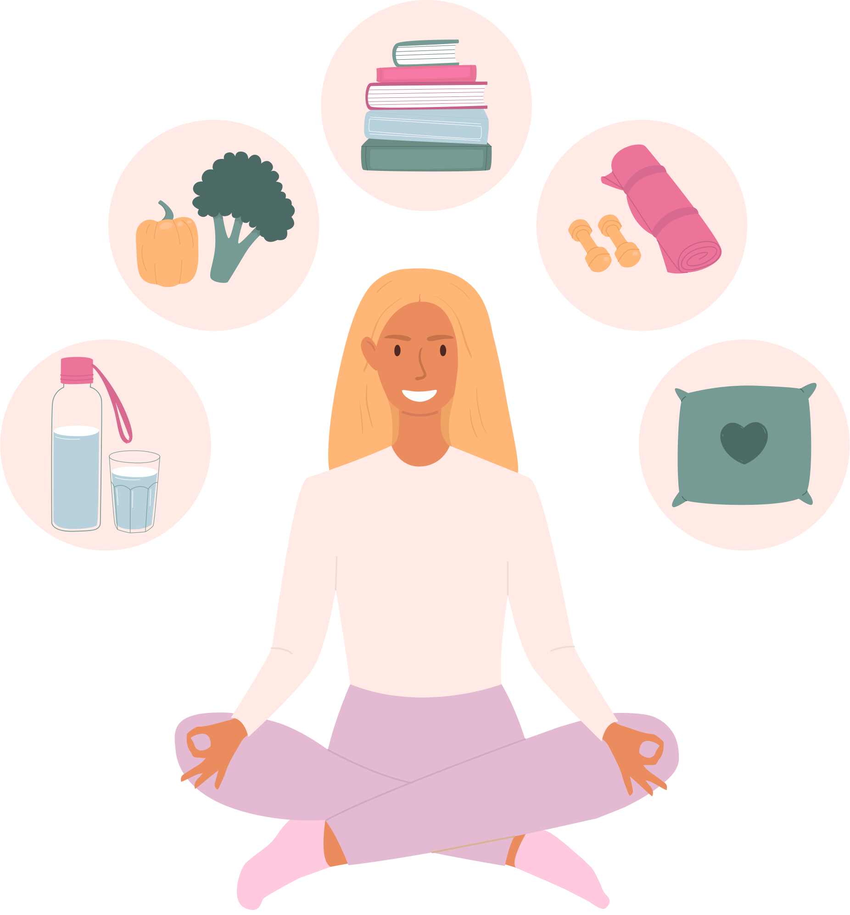
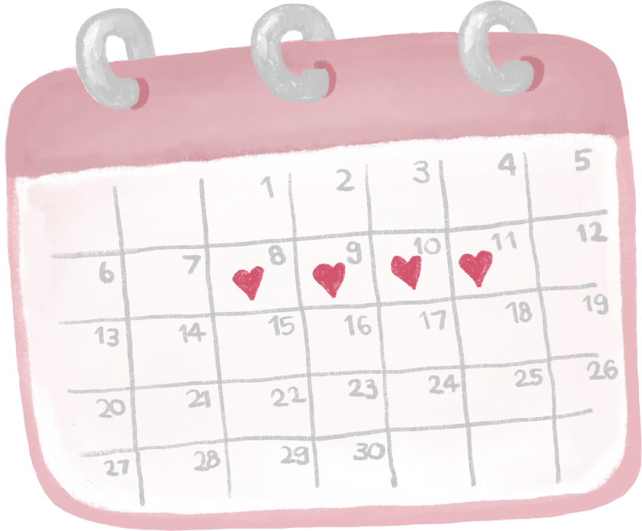
Period Education
UK
How can menstruating people take action to improve symptoms?
Be prepared
Carry period products or ask for products. Cycles may be irregular to start, or periods may come unexpectedly. Schools should have period products freely available.
Track the menstrual cycle
Tracking their cycle and logging symptoms will help them learn about themselves. We’ll go into more detail on this.
Be proactive
Try the following lifestyle advice to reduce unwanted symptoms.

Slide 11
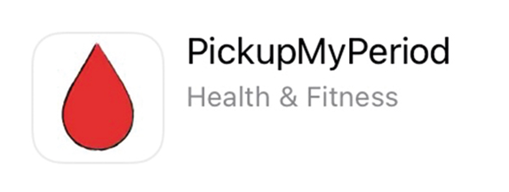
Period Education
UK
Be prepared
All schools in the UK should have access to free period products to give to pupils.
There is no need to be embarrassed in asking for period products. They are there to help all menstruating young people.
Outside of school, there is an app called PickUpMyPeriod so that anyone can find free products in Scotland. The app is free and available for download on Android and Apple devices.

Slide 12
Period Education
UK
Tracking the Menstrual Cycle
Apps, diaries or calendars can be helpful in tracking
Complete for a minimum of 3 cycles before ‘patterns’ can be seen
Note things like stress, sleep, travel, changes in diet and exercise training for sport alongside symptoms as these may affect symptoms you experience.
Keep a track of:
Menstrual cycle length
Bleeding length
Heaviness of bleeding
Symptoms

Slide 13
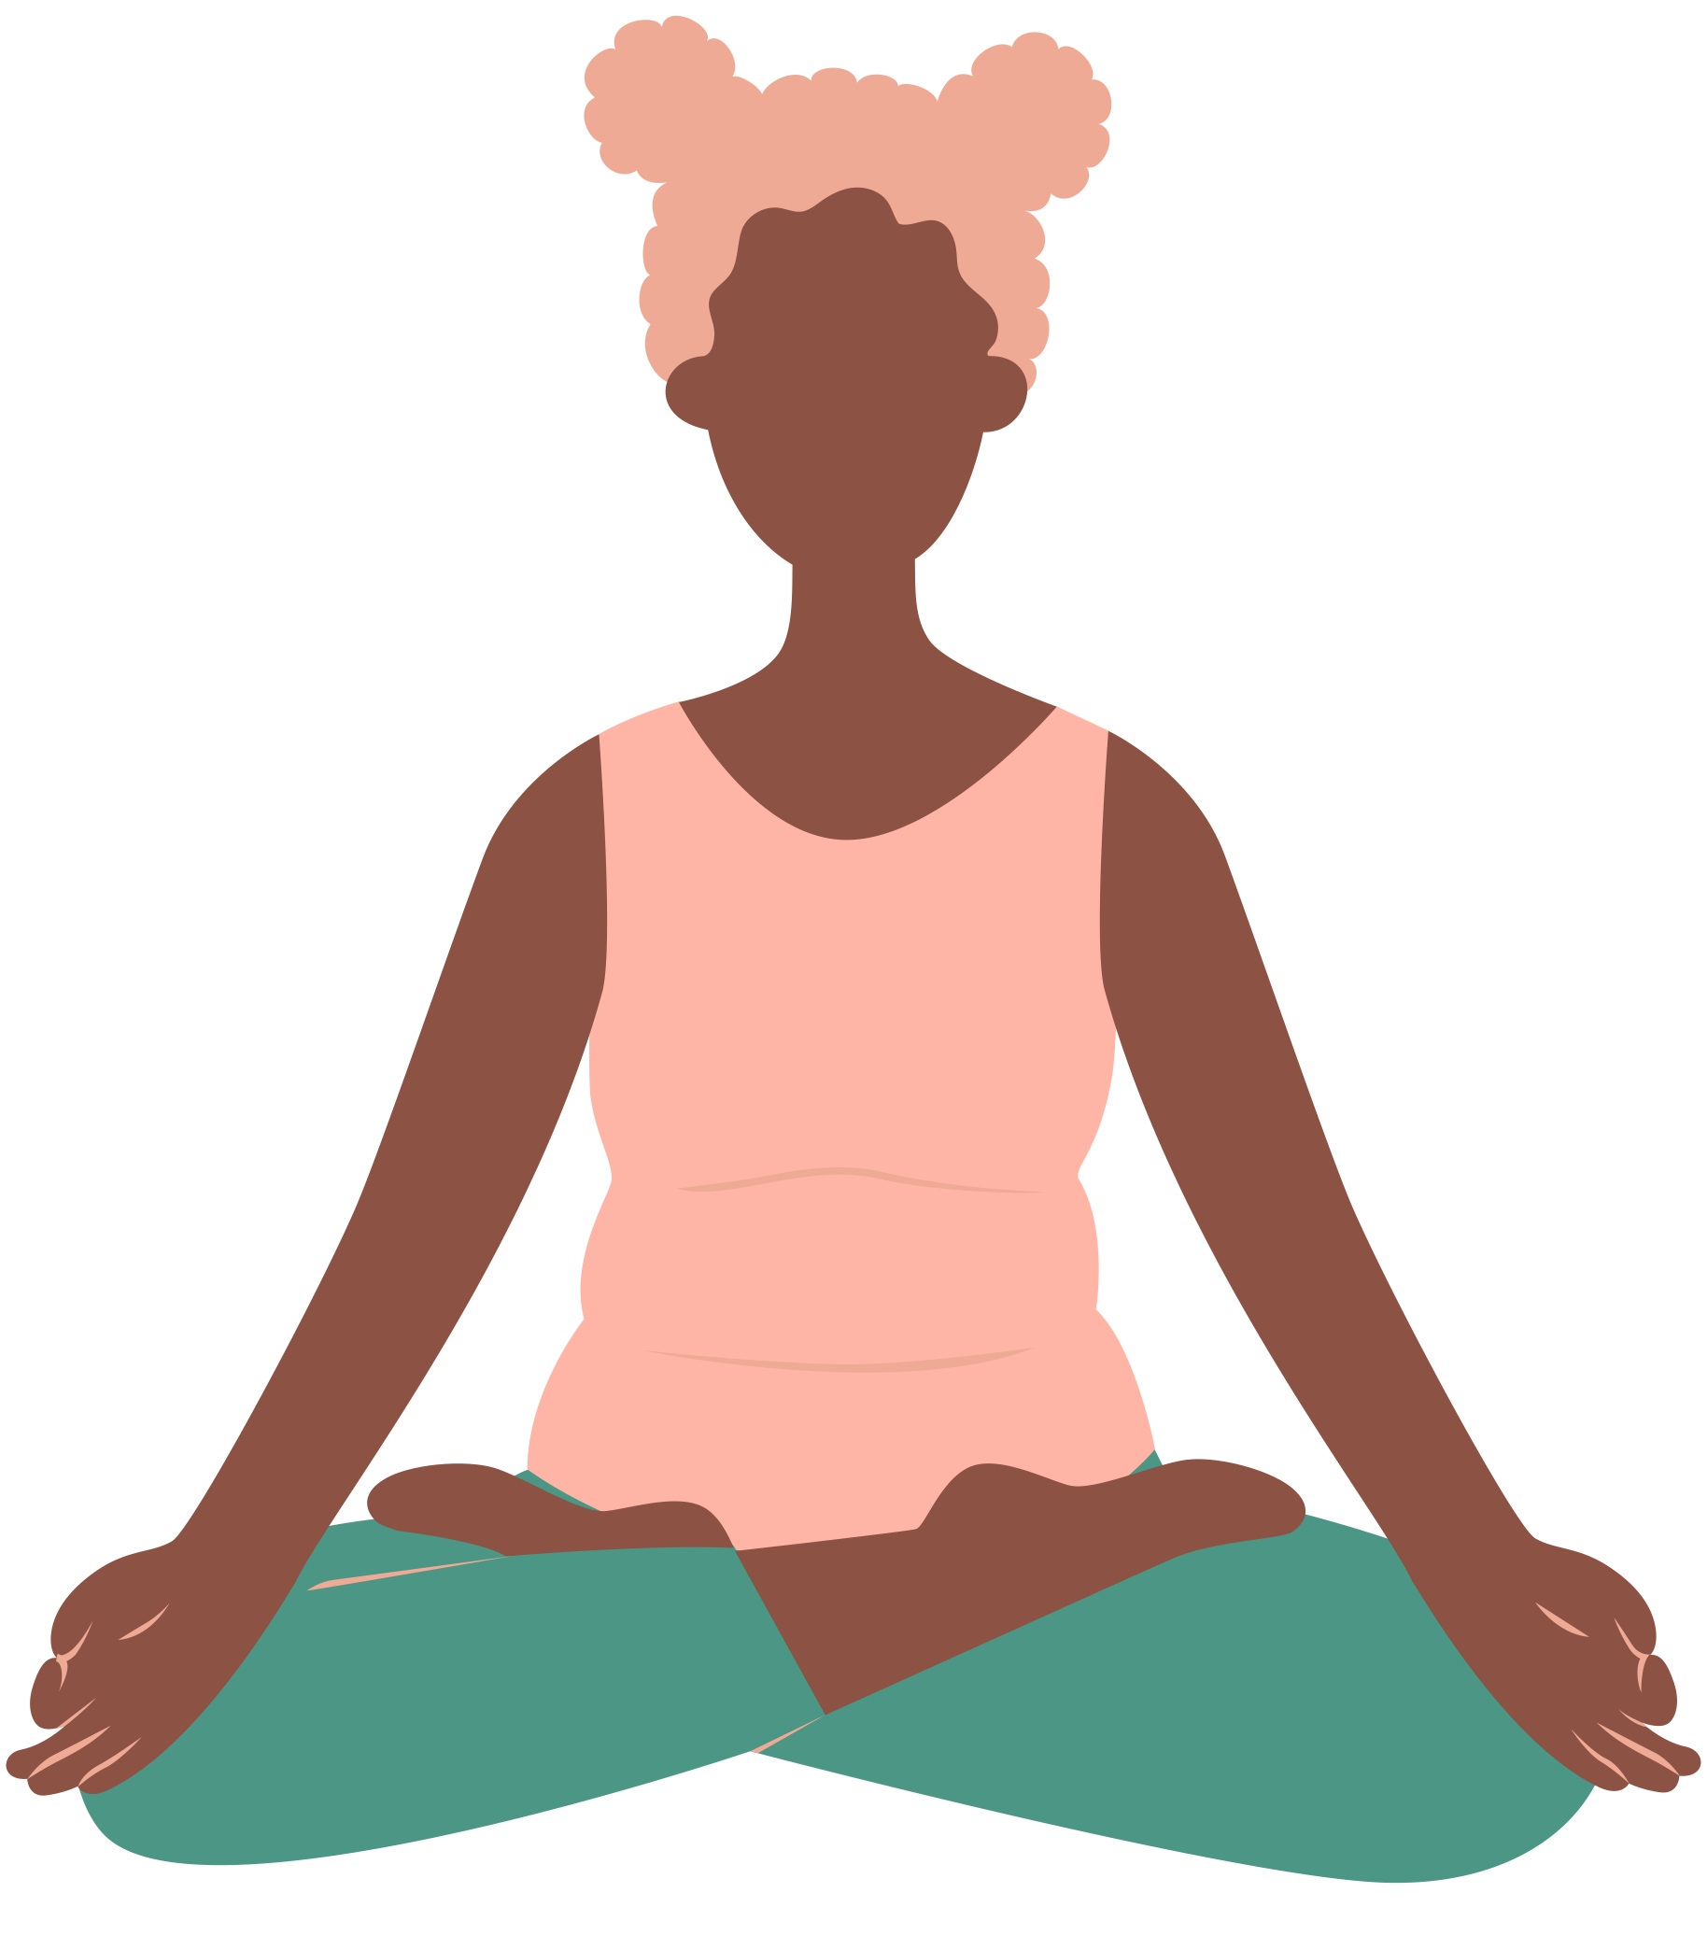
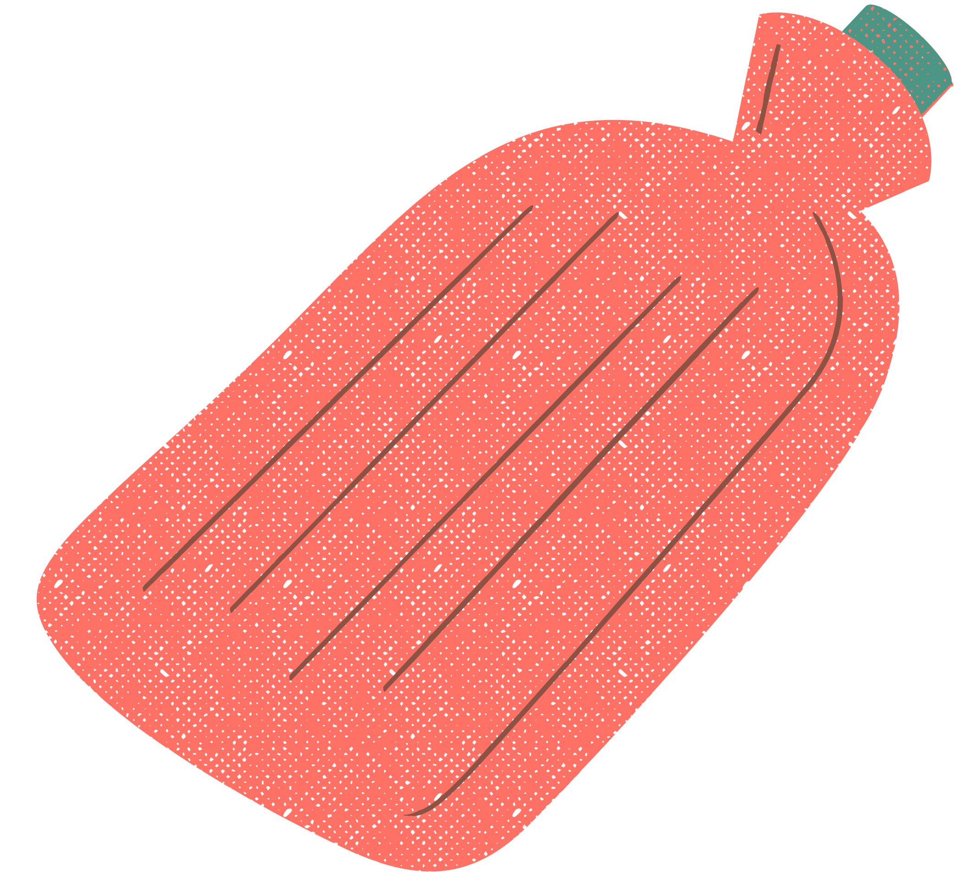
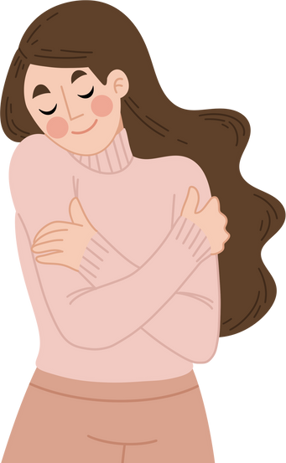
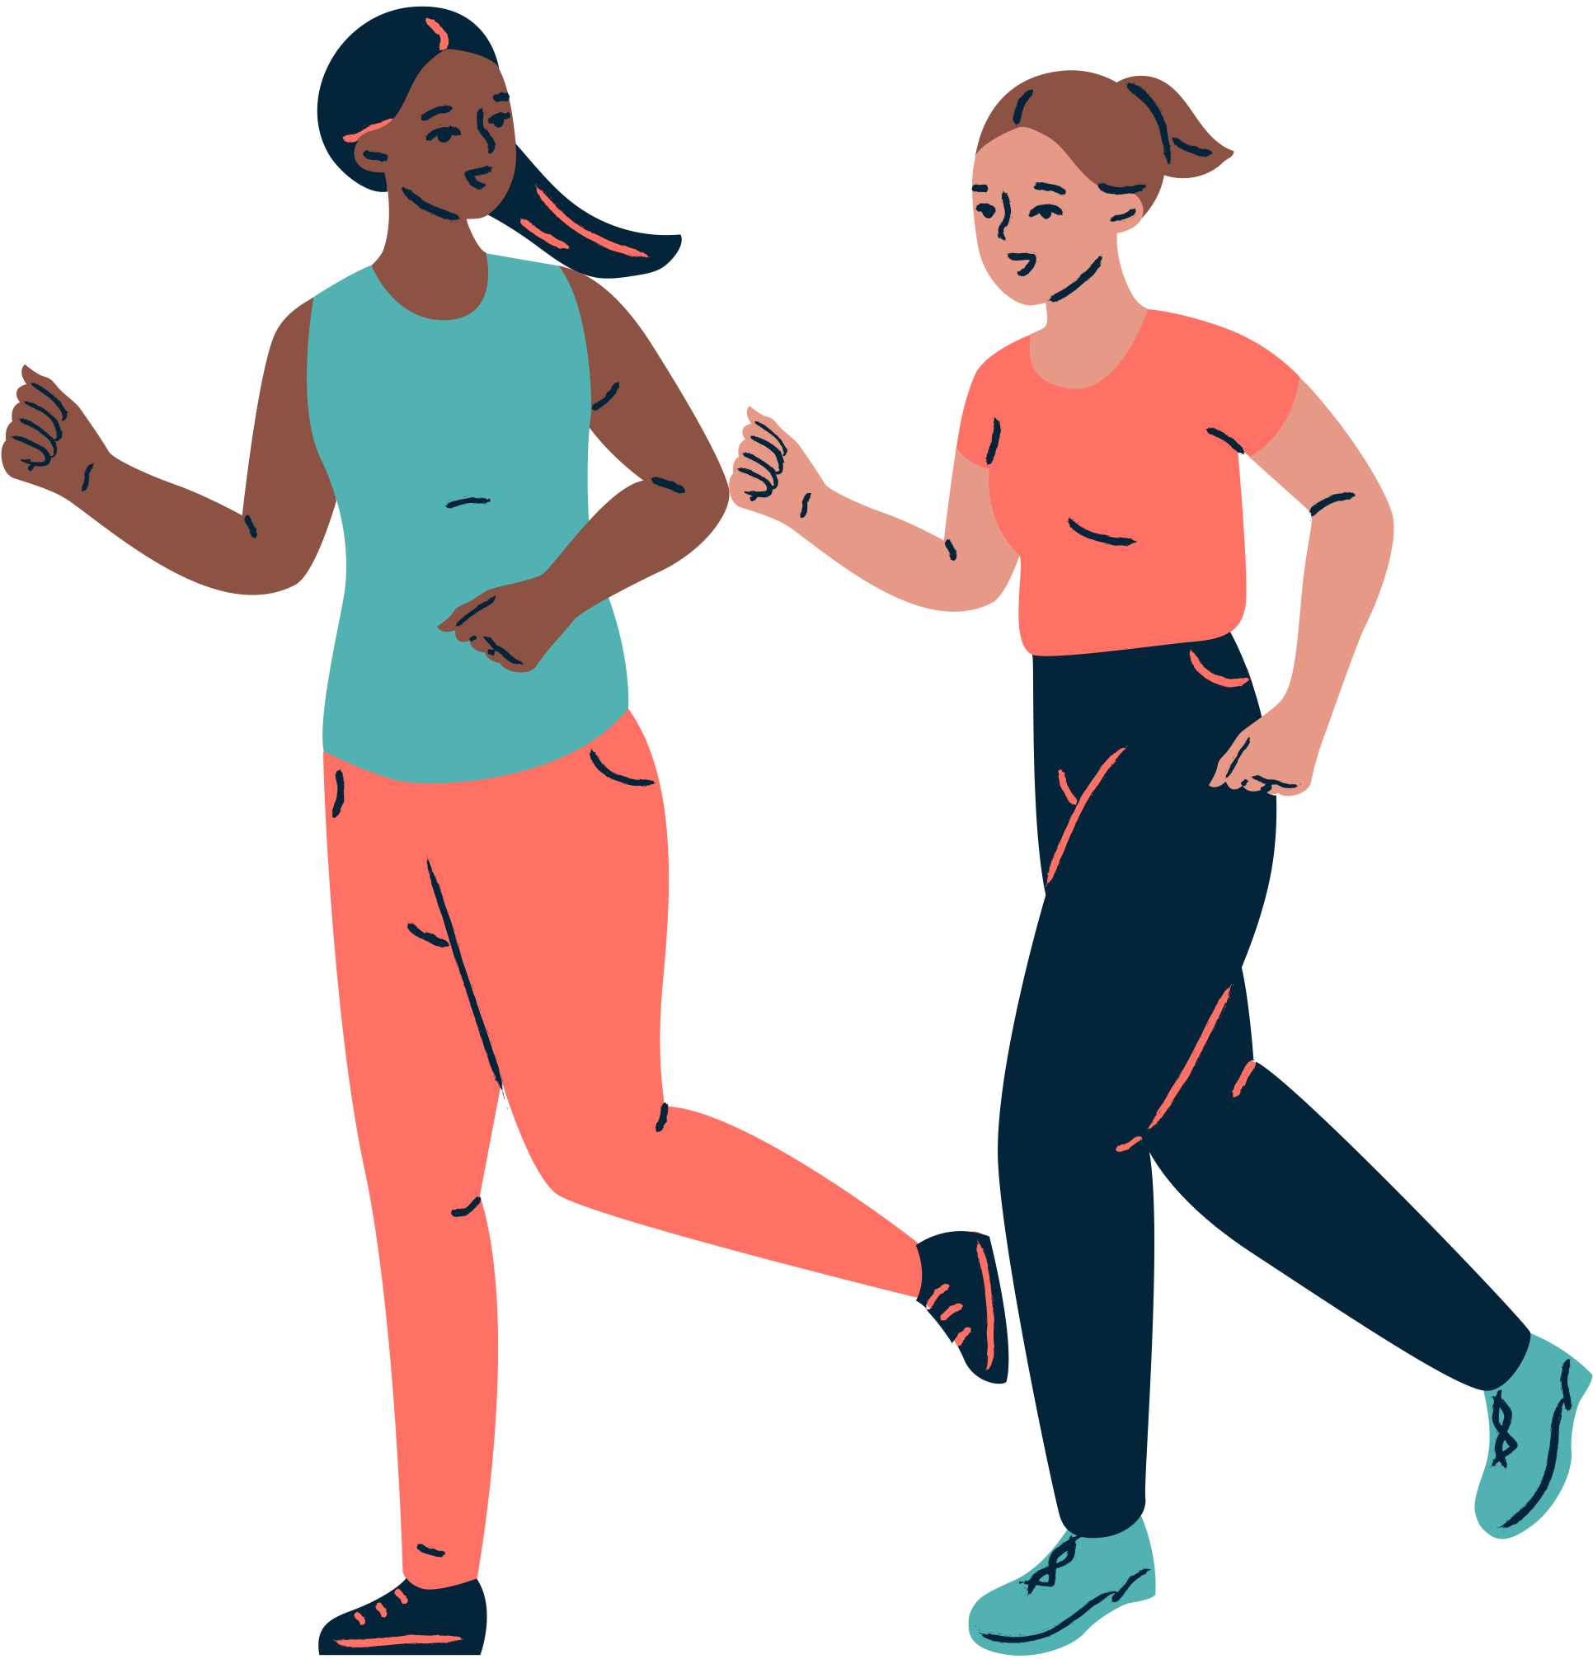
Be Proactive - Lifestyle Advice for Symptom Management
Period Education
UK
Manage stress
Heat for abdominal/back pain
Good sleep habits
Eat a well-balanced diet
Be kind to yourself!
Exercise, physical activity and stretching
Some medications*
*Never take over-the counter medications without discussing with a medical professional and parent/guardian. Always follow the instructions

Slide 14
Period Education
UK
Manage stress
Good sleep habits
Heat for abdominal/back pain
Eat a well-balanced diet
Be kind to yourself!
Many menstruating people wonder whether it is okay to work out during their period. The answer is yes!
Some people can continue their normal exercise or training regimes before and during their period, whilst others may need to change it.
Scientific studies show that physical activity, stretching and exercise can help to reduce most physical and mental symptoms.
Exercise, physical activity and stretching
Some medications*
Exercise, physical activity and stretching

Slide 15
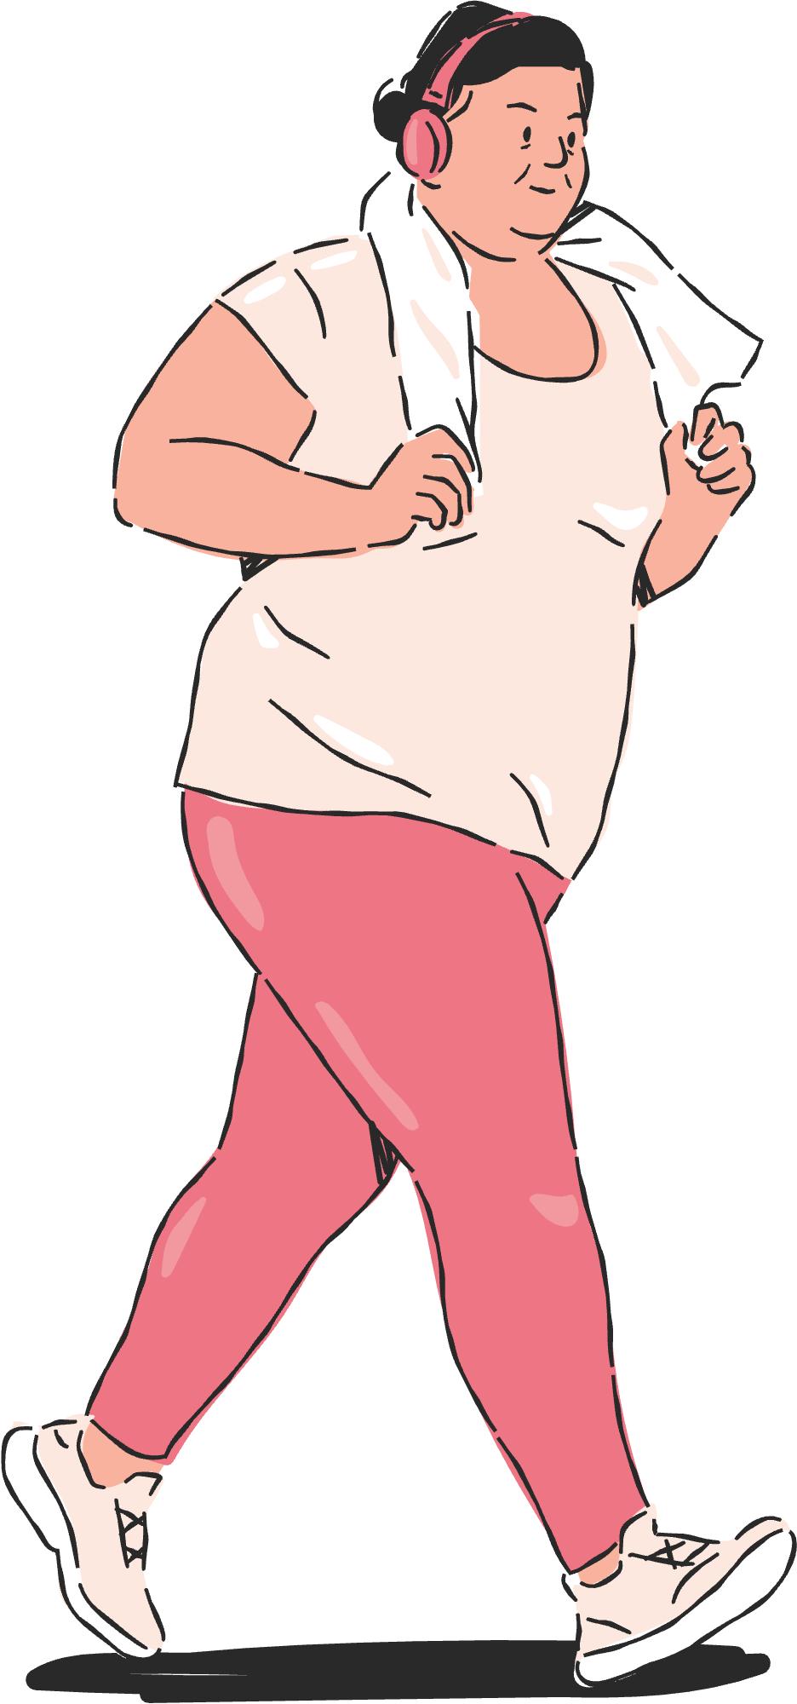
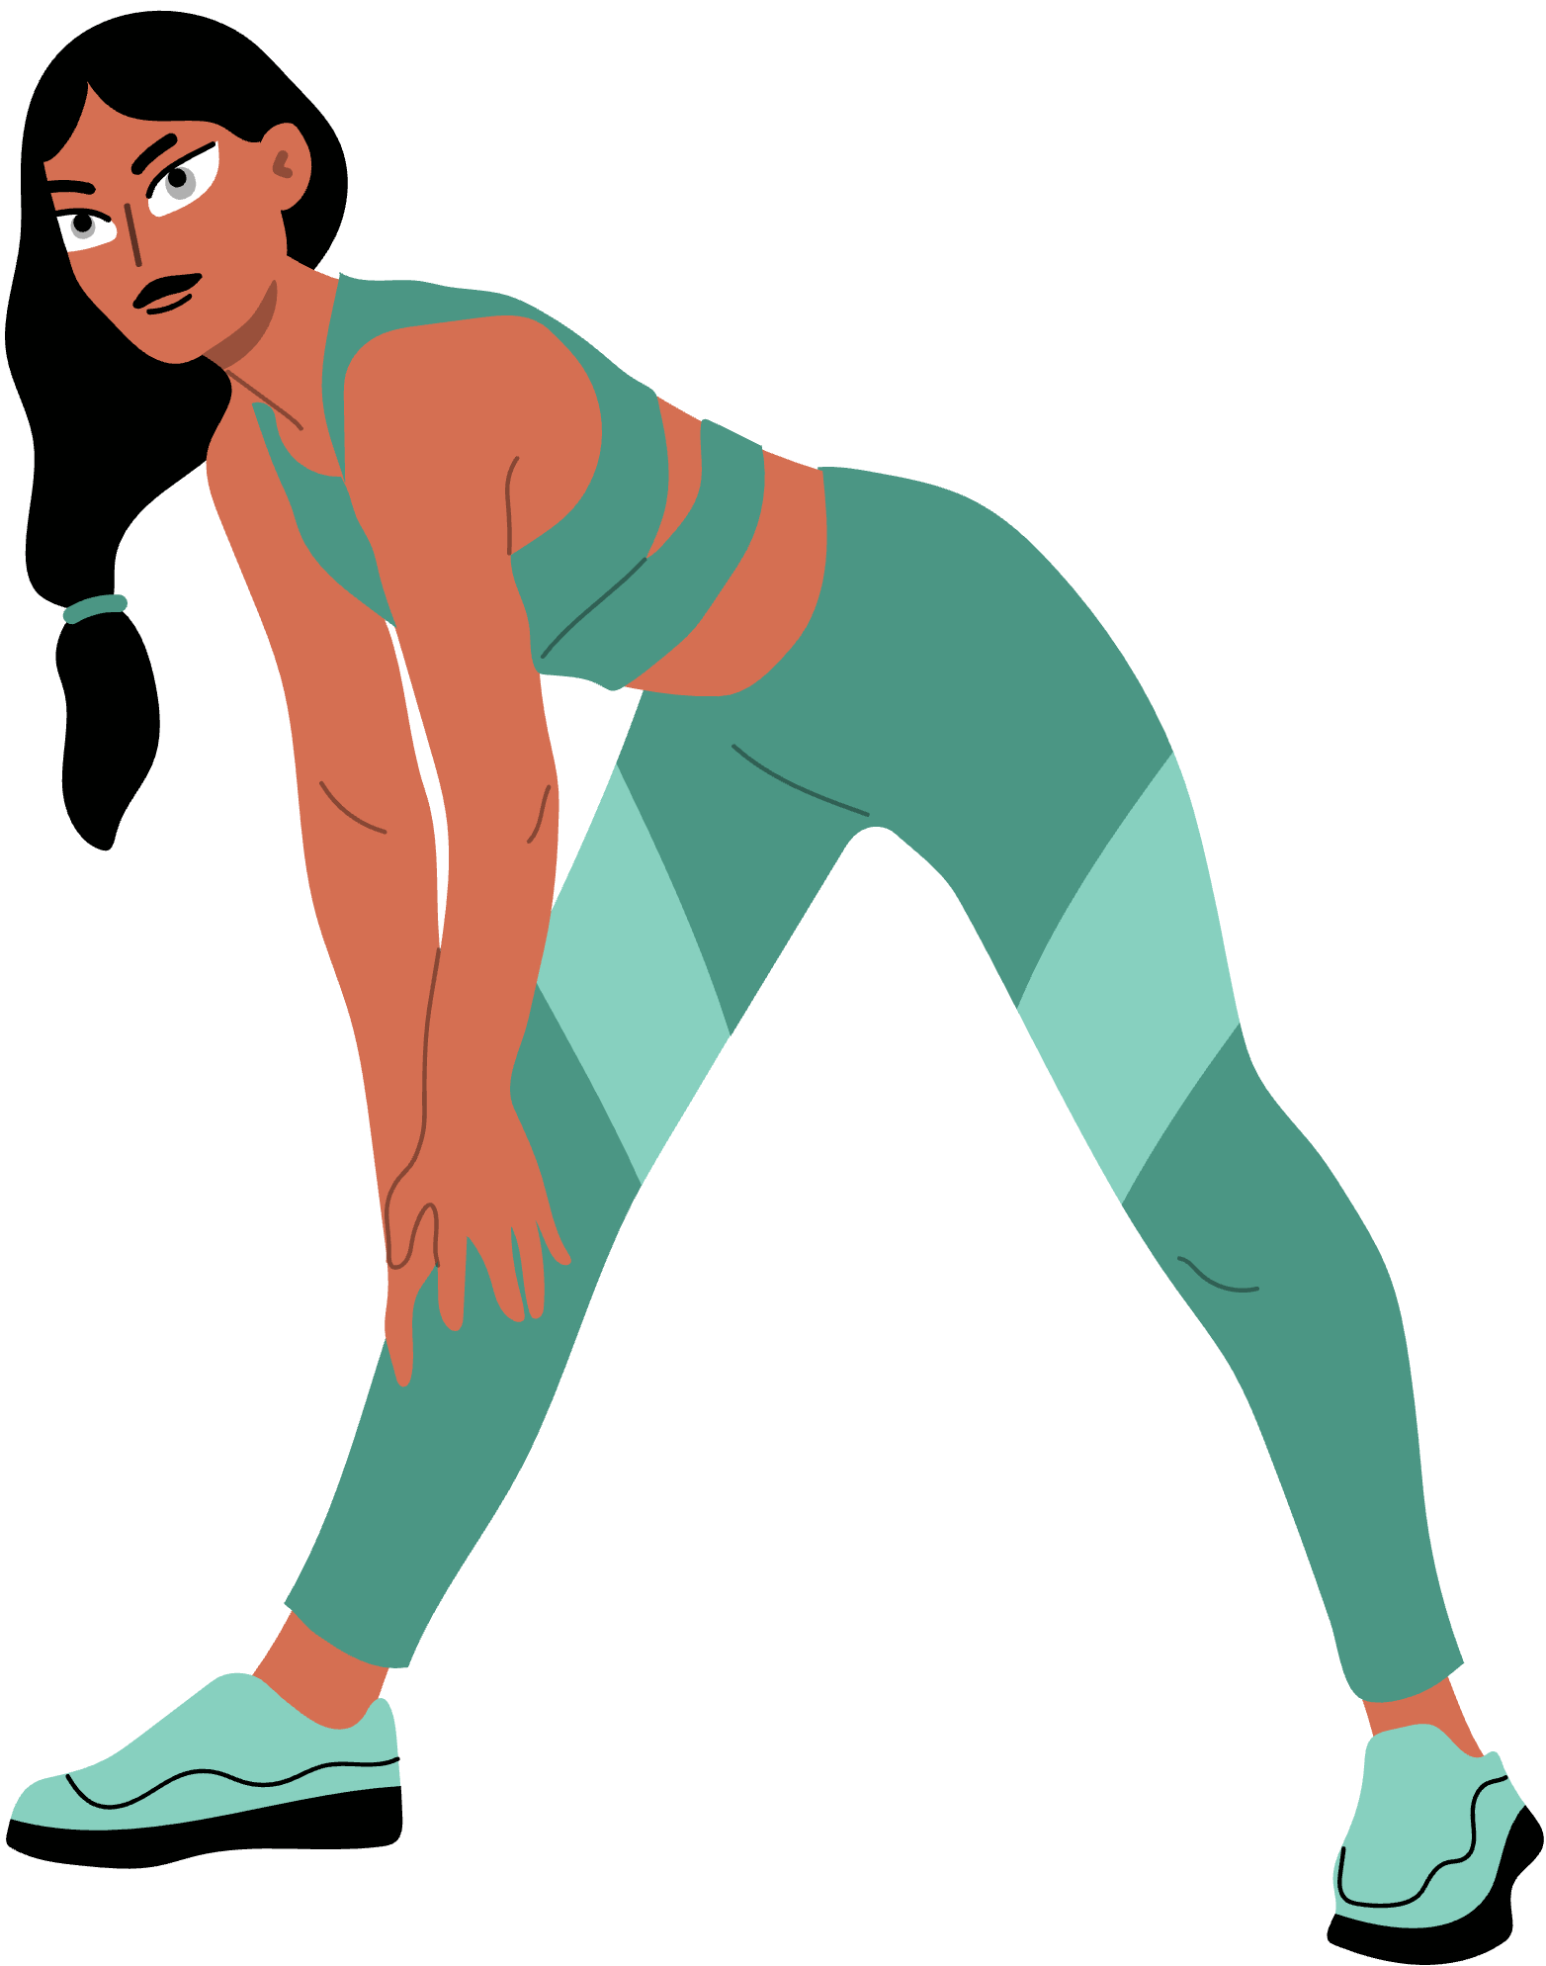
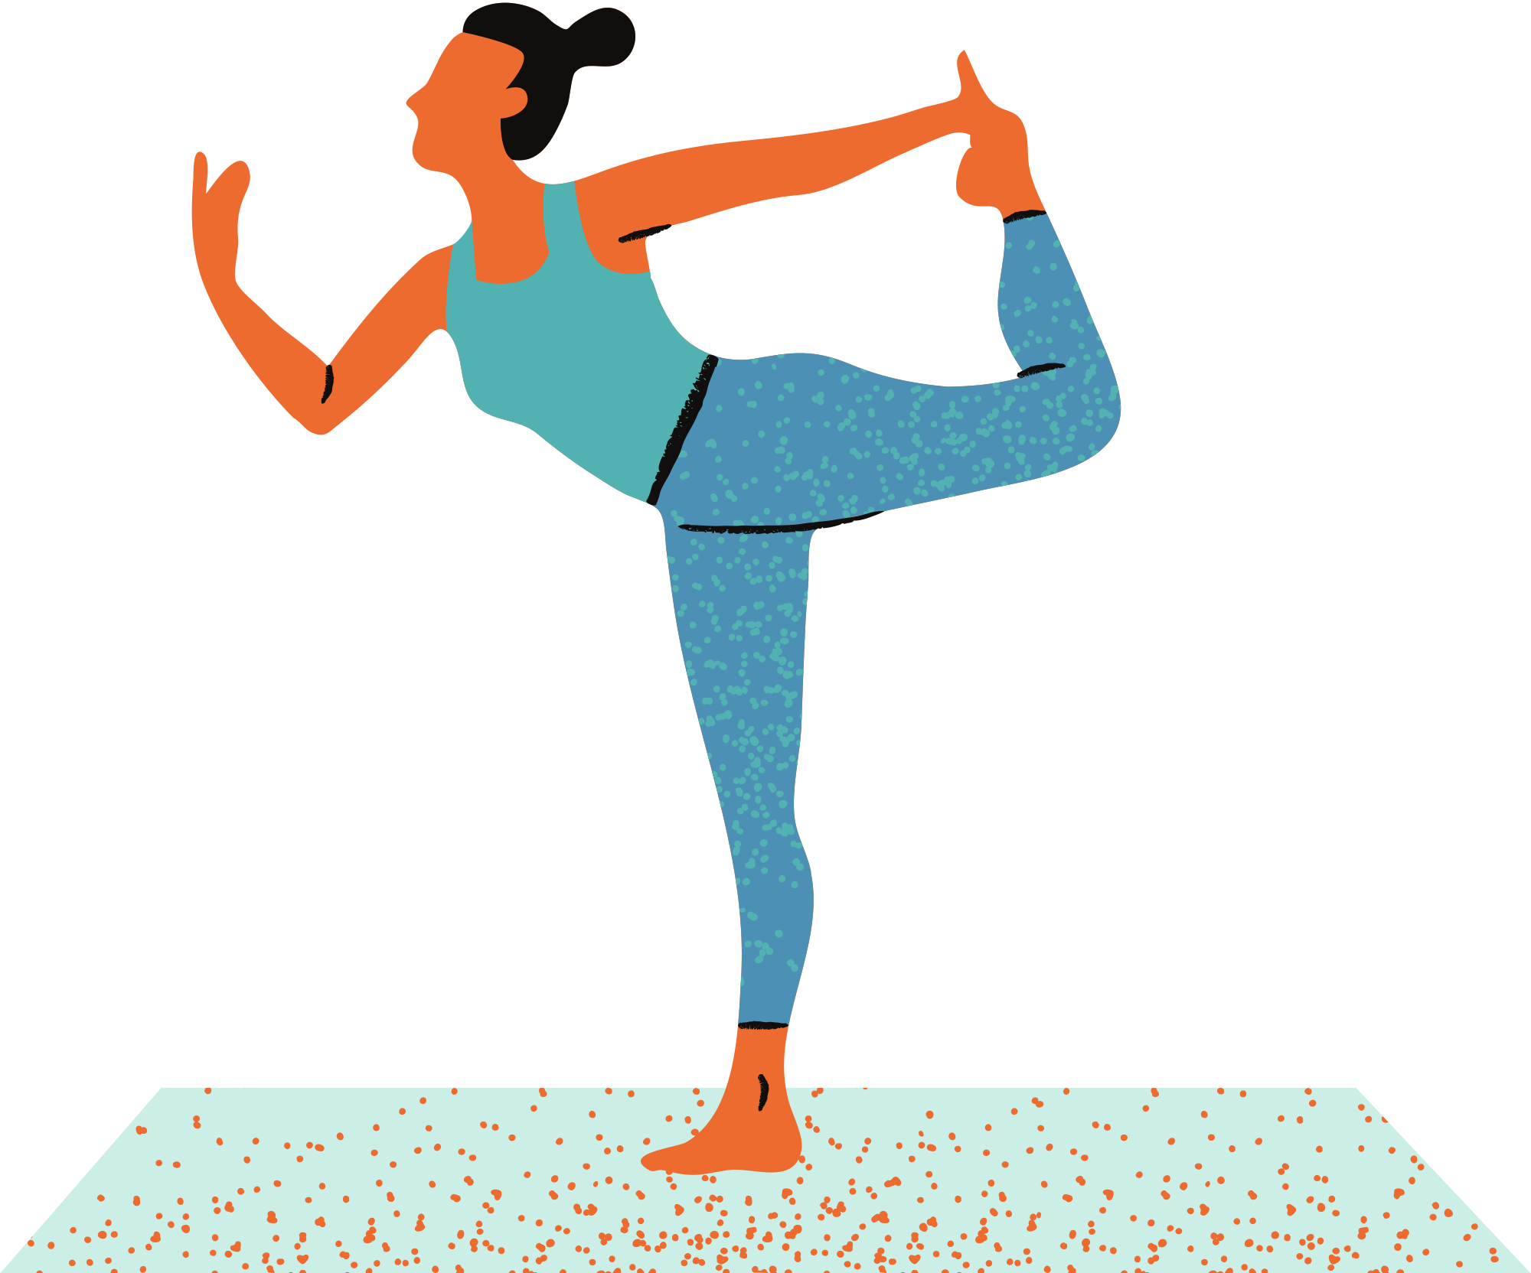
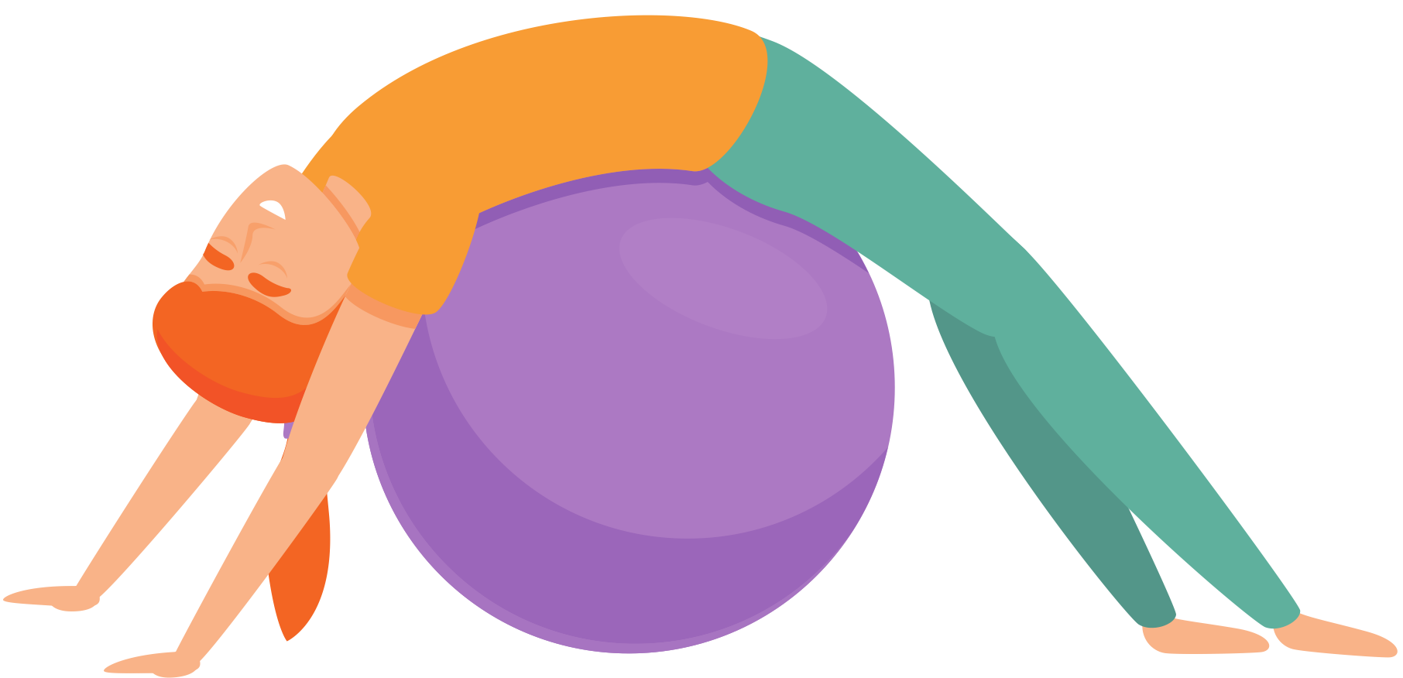
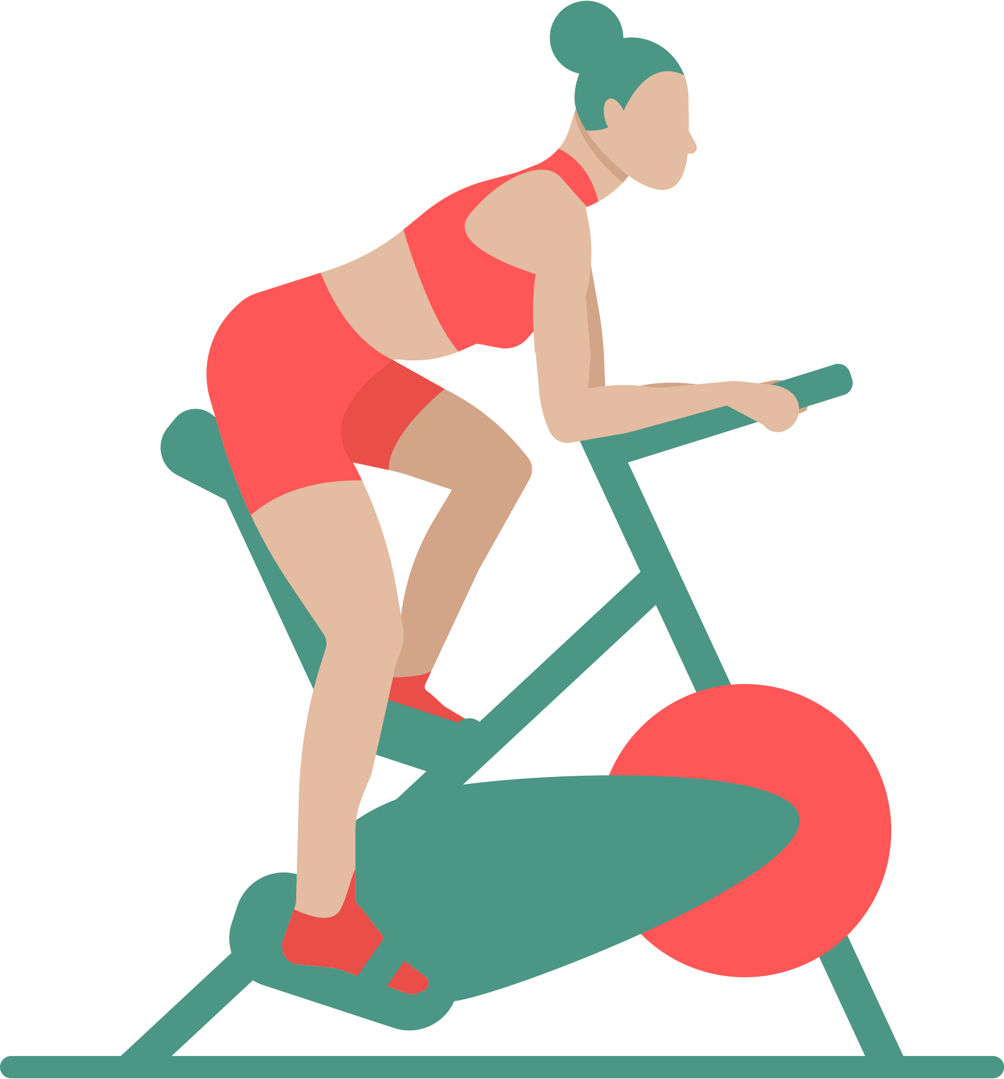
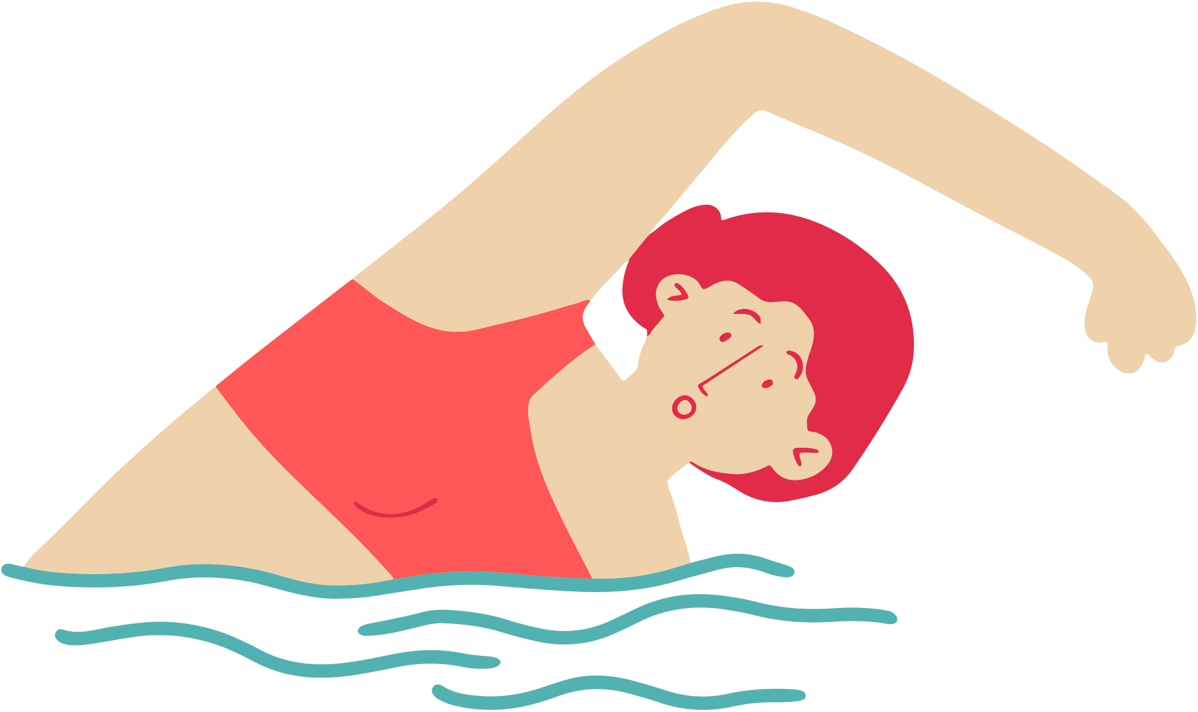
Period Education
UK
What activities would be included in this?
The next session will talk more about physical activity, exercise and PE
Manage stress
Good sleep habits
Heat for abdominal/back pain
Eat a well-balanced diet
Be kind to yourself!
Exercise, physical activity and stretching
Some medications*
Exercise, physical activity and stretching

Slide 16
Period Education
UK
Manage stress
Good sleep habits
Heat for abdominal/back pain
Eat a well-balanced diet
Be kind to yourself!
A well-balanced diet will help give you more energy, help with bloating, cravings, headaches and may reduce pain.
If you can, don't eat too many processed high fat foods such as takeaways, sugary drinks, crisps, chocolate, cake.
Try to get at least 5 fruits or vegetables in every day, especially when menstruating.
Exercise, physical activity and stretching
Some medications*
Eat a well-balanced diet

Slide 17
Period Education
UK
Manage stress
Good sleep habits
Heat for abdominal/back pain
Eat a well-balanced diet
Be kind to yourself!
Sleep is vital for everyone. It is even more important for adolescents as your brain and body are still developing.
Adolescents need 8-10 hours of sleep! Half of adolescents don’t get this!
Good quality sleep is needed for good emotional and physical health and to be at your best for school, socialising and any extra-curricular activities you enjoy.
Exercise, physical activity and stretching
Some medications*
Good sleep habits

Slide 18
Period Education
UK
Manage stress
Good sleep habits
Heat for abdominal/back pain
Eat a well-balanced diet
Be kind to yourself!
Exercise, physical activity and stretching
Some medications*
Sleep can help most menstrual related symptoms e.g. reducing feelings of tiredness, irritability, anxiety, cravings, changes in appetite, concentration …
Before or during menstruation some people feel their sleep is more disrupted or need more sleep.
Good sleep habits

Slide 19
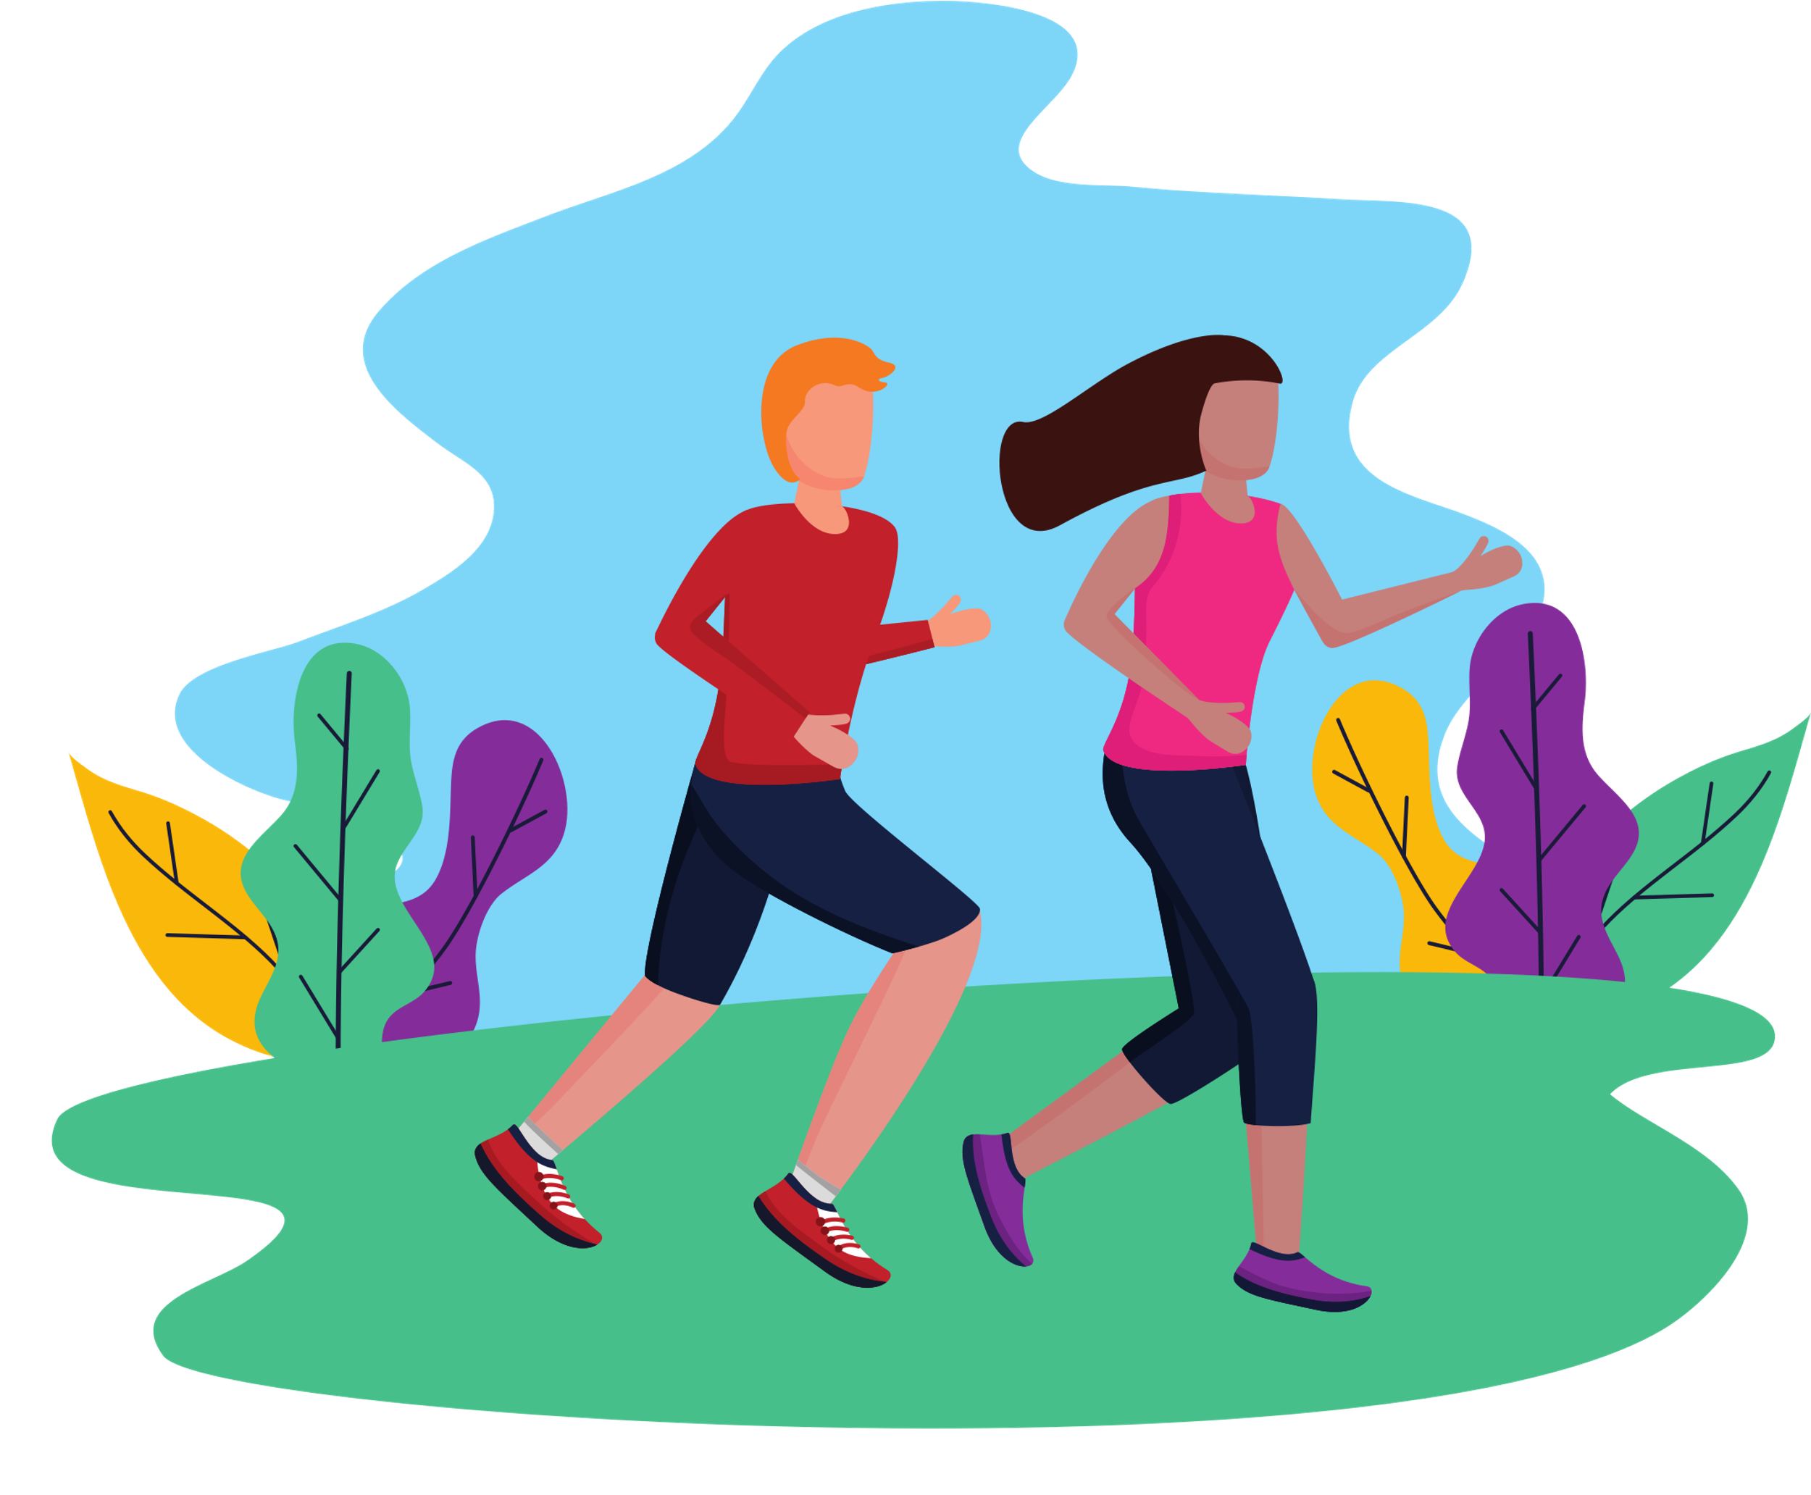
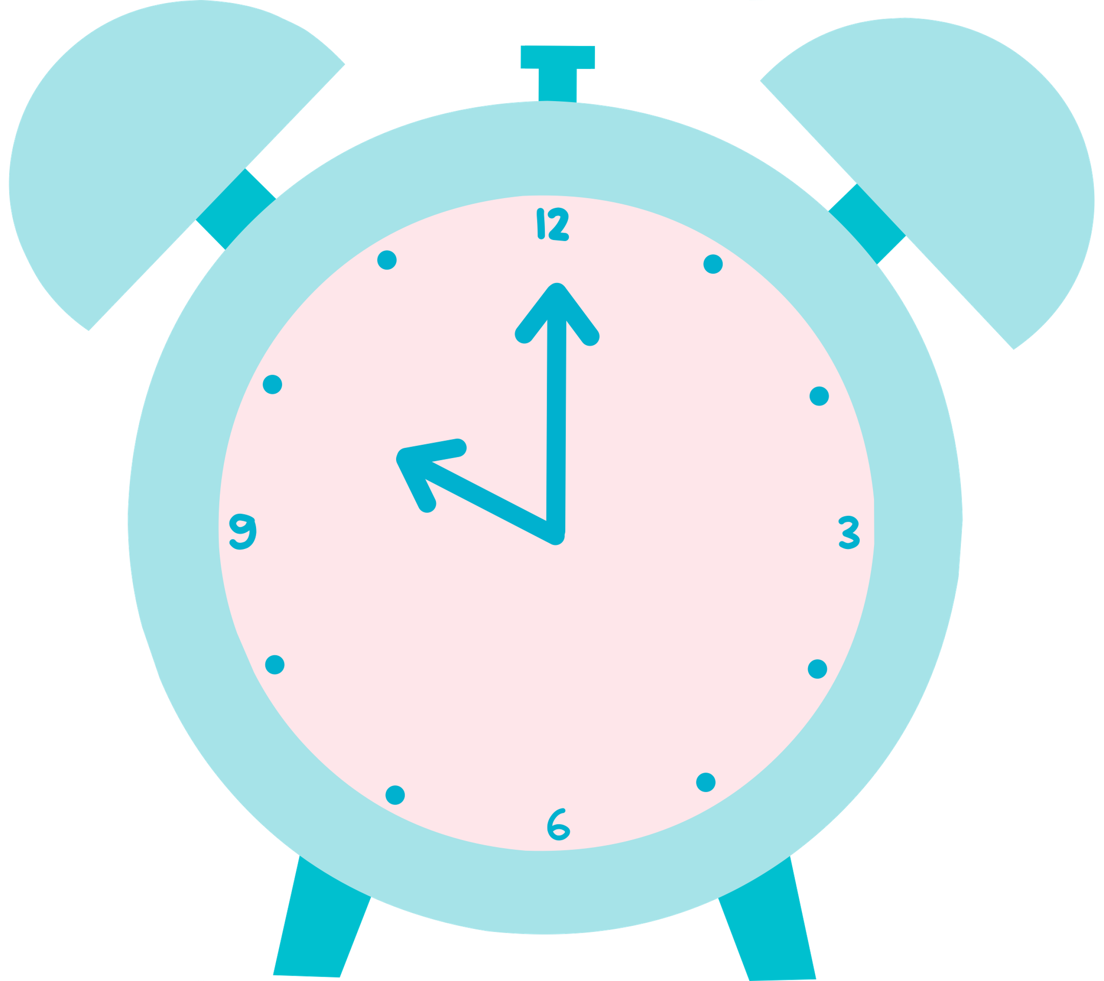
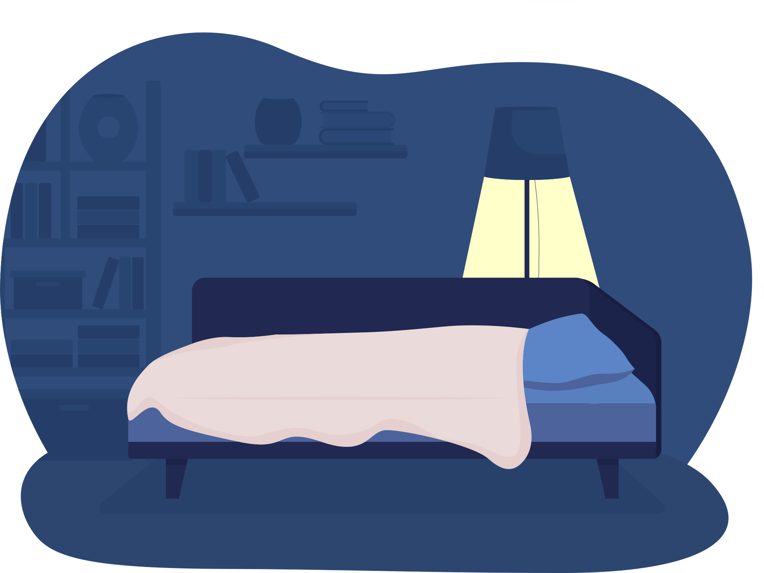
Improving sleep length and quality
Period Education
UK
Manage stress
Good sleep habits
Heat for abdominal/back pain
Eat a well-balanced diet
Be kind to yourself!
Exercise, physical activity and stretching
Some medications*
Go to bed at the same time each night (unless more is needed before/after a period)
Start the day with sunlight
Exercising during the day or early evening
Good sleep habits
Limit caffeine, especially in the afternoon and evening
Limit screen time in the evening and especially one hour before bed
A cool, dark and quiet bedroom

Slide 20
Period Education
UK
Manage stress
Good sleep habits
Heat for abdominal/back pain
Eat a well-balanced diet
Be kind to yourself!
The menstrual cycle can become longer or shorter, periods may stop altogether, or symptoms can be worse if your body is under physical or emotional stress.
What things help with reducing stress?
Exercise, physical activity and stretching
Some medications*
Manage stress

Slide 21
What things help with reducing stress?
Period Education
UK
Manage stress
Good sleep habits
Heat for abdominal/back pain
Improve sleep habits
Eat a well-balanced diet
Be kind to yourself!
Eating a well-balanced diet
Exercise, physical activity and stretching
Some medications*
Socialising
Breathing exercises and meditation
Planning for times you might not be as productive can also help (e.g. studying more in certain times of the month).
Exercising
Manage stress
Mindfulness
Confiding in friends and family
Whatever works for you!
Avoiding social media if you need to!

Slide 22
Period Education
UK
Manage stress
Good sleep habits
Heat for abdominal/back pain
Eat a well-balanced diet
Be kind to yourself!
Exercise, physical activity and stretching
Some medications*
Heat is thought to help relax the muscles which are helping to contract the uterus so that it can shed its lining. It can help period pain and cramping symptoms.
Apply heat (but not too hot!) to the abdomen or back as soon as symptoms begin.
Heat for abdominal/ back pain

Slide 23
Period Education
UK
Manage stress
Good sleep habits
Heat for abdominal/back pain
Eat a well-balanced diet
Be kind to yourself!
Knowing about the menstrual cycle, periods, the different symptoms experienced and tracking the cycle can help people understand why they may not feel as productive at certain times of their cycle.
Understanding that the feelings will pass is sometimes enough!
Exercise, physical activity and stretching
Some medications*
Be kind to yourself!

Slide 24
Period Education
UK
Manage stress
Good sleep habits
Heat for abdominal/back pain
Eat a well-balanced diet
Be kind to yourself!
Exercise, physical activity and stretching
Some people choose to use medications to help with period pain.
Never take over-the-counter medications without discussing with a medical professional (e.g. pharmacist or doctor). Always follow the instructions as medications can cause harmful symptoms if not used properly.
Some medications*
Some medications

Slide 25
Period Education
CASE STUDY
UK
A day in the life of Danielle...
Identify and plan things to help manage symptoms
Danielle wakes up and it is day 1 of her period. She is bleeding and experiencing stomach cramps and is feeling very tired, with a low mood.
What could she do to make herself feel better:
Before school
When she gets to school
During school
At her extra-curricular activity
Once she gets home
Before she goes to bed
What might Danielle be mindful of/ bring with her/ look out for?

Slide 26
Period Education
UK
SUMMARY
People have different menstrual cycle experiences with different symptoms
There are many lifestyle strategies that can be used to try and reduce any unwanted menstrual cycle symptoms. These include:
Exercising, doing physical activity and stretching
Eating a well-balanced diet
Having good sleep habits
Managing stress
Heat for abdominal and back pain
*Some over-the-counter medications
*Never take over-the counter medications without discussing with a medical professional and parent/guardian. Always follow the instructions

Slide 27
Authors ​and contributions:
Content developed by Dr Laura Forrest*, Dr Natalie Brown and Beky Williams.
Associated activities co-designed by Dr Laura Forrest, Dr Natalie Brown, Beky Williams, Dr Shirley Gray, Elaine Wotherspoon, Julie Isdale, Tilly O'Donnell.
Valuable feedback received from Megan Padden, Tracy Johnston, Dr Jessica Piasecki and Dr Georgie Bruinvels.
*Dr Laura Forrest was supported by the Royal Society of Edinburgh Research Fellowship during the development of these resources
​
Period Education ©2023 (www.periodeducation.org)​
All rights reserved. These resources may be reproduced by anyone working to promote the menstrual health of women and girls as long as it is clearly referenced. It may not be used for commercial purposes unless written permission has been obtained from Period Education. ​

