Slide 1

Period Education
UK
Menstrual Cycle Education in Schools
Peer co-design
Notes:
Note for teachers: We encourage you to watch our peer-led period education video first to help bring this session to life!

Slide 2


Period Education
UK
SESSION AIMS
Develop an understanding of why peer-led period education is important.
Identify what resources and support you need to deliver period education to your peers.
Create a plan for peer-led period education in your school.
Notes:
Note for teachers: This session could be delivered within one hour, but may be longer depending on how much the girls talk and plan.

Slide 3

Period Education
UK
Safe, respectful and inclusive environment
Respect – listen to and be open to the views of others, acknowledge individual differences. There is no pressure to answer any questions and you can do so without reason provided.
Confidentiality – questions and session discussions today are kept confidential within this group and not used to shame, bully or tease individuals outside of this space. Please be supportive of one another.
Open environment – ask any questions throughout the session.
Notes:
Note for teachers: place emphasis on creating a safe environment from the start

Slide 4

Period Education
UK
Menstrual education and periods
1 in 4 girls did not feel they knew what to do when they started their period
48% of girls feel embarrassed by their period
70% avoid sport during their period
Notes:
Note for teachers: Scene setting, context as to why developing peer-led education is important.

Slide 5
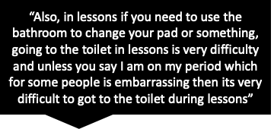

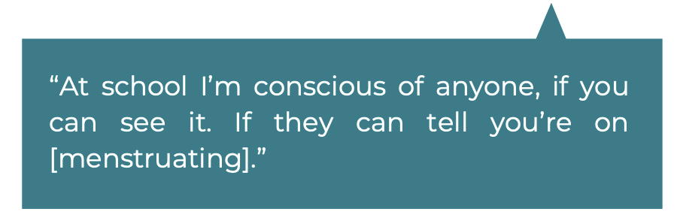

Period Education
UK
Pupils’ Experiences – what girls have said...
Notes:
Note for teachers: Direct quotes from girls who have been involved in research focus groups. Encourage pupils to reflect on how the quotes make them feel, do they sound familiar, have they had similar thoughts/experiences etc?

Slide 6
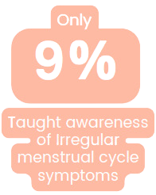
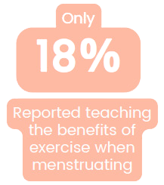
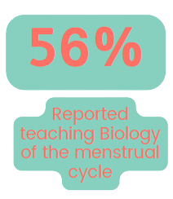

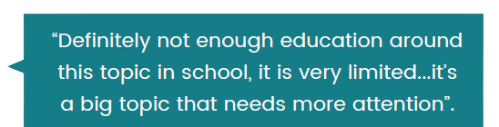
Period Education
UK
What we know from teachers
Notes:
Note for teachers: Ask girls whether this aligns to their experience of what they've been taught i.e. more biology and products versus symptoms

Slide 7
Period Education
UK
What girls have requested...
"tips to deal with it [menstruation], like from the older female pupils like they know more tips about it"
"Peer support"
Notes:
Note for teachers: Quotes from girls who took part in focus groups – they have requested peer-led education.

Slide 8
Period Education
QUESTIONS
UK
1. Do you think it is important or helpful to learn about periods at school?
2. Have you received menstrual education in school?​
3. What made the lesson good or bad?
4.
Quick Questions!
Do you talk to each other/friends about your periods?
Notes:
Note for teachers: Warm-up activity to get girls thinking/reflecting/talking. Divide the room into two sides with a sliding scale in between. Ask girls to stand at one end if they strongly agree or the other end if they strongly disagree. They can stand in the middle, or at any point on the sliding scale. After girls have chosen their position, ask why they have selected where they have stood and get them to expand on this.

Slide 9
Period Education
UK
Scenario - you overhear a small group of year 7 students telling one another that they don't really understand what period symptoms are. They weren't taught this by their primary school and it's not been mentioned in PSHE lessons since.
How would you deliver menstrual education to other pupils?
Your task – design a lesson to help increase their knowledge and awareness of symptoms.
What would you include in your lesson? How would you deliver it?
What do you think girls need to know?
Notes:
Note for teachers: Suggested group size of 2-4 for scenario discussions. Encourage groups to feedback. See symptoms on the next slide to help girls.

Slide 10
Ill/cold symptoms
Period Education
Irritable/agitated
UK
Poor control
Constipation
Headache
Worry/anxiety
Dizziness
Sick/nausea
Abdominal pain
Heavy bleeding
Distracted/emotional
Reduced motivation
COMMON MENSTRUAL RELATED SYMPTOMS
Bloating
Backache
Bad skin
Changes in appetite/
food craving
Clumsiness/​
reduced​
coordination
Fatigue/tiredness
Weight changes
Mood swings
Reduced recovery
Diarrhea
Trouble sleeping
Breast pain/change size
Poor temperature regulation

Slide 11
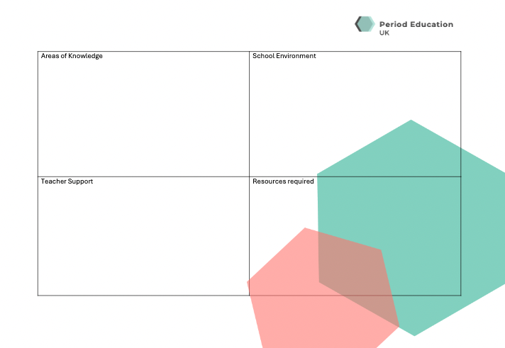
Period Education
Quadrant activity
UK
What do you need to help deliver period education in your school?
Notes:
Note for teachers: Print out the quadrant activity before the session and get girls to complete this individually first. Once they have done this, use flipchart paper, with a heading for each quadrant and encourage girls to move around the classroom and write their top priorities/answers against each one. Encourage group conversations at each flipchart station (for larger groups, make sure pupils are divided into 4 groups). The final part of this activity is to ask each pupil to put a sticker next to the most important point on each flipchart paper, to collectively decide what they want to prioritise.

Slide 12
Period Education
UK
Card Game Planning!
What does peer-led period education look like in your school?
There is a set of cards with different questions e.g. Who will we deliver period education to?
There are a set of responses for each question to choose from to help decide how to deliver peer education in your school. The cards are colour-matched.
If you think a different option would be better, you can use your 'wild card' and share your preferred answer to the question.
Notes:
Note for teachers: Download the template from periodeducation.org to print out your cards. The colour matched cards each have a question and a range of possible answers. Pupils can use the cards to design what peer-led period education will look like in your school. We recommend allocating time to discuss the answers and take a photo of the responses so you can use this in future planning.

Slide 13
Period Education
UK
Actions and next steps
Teacher - Collate information from today’s and identify where pupils would like support.
Pupils – Work with your teacher to organise a time to deliver your period education (based on prompt cards logistics you have chosen).
Notes:
Note for teachers: Finalise actions and identify who is doing what.

Slide 14
Period Education
UK
Thank you

