Slide 1
Period Education
UK
Menstrual Cycle Essentials
Session 1

Slide 2
Period Education
UK
SESSION AIMS
To develop your awareness of what a normal menstrual cycle is and what is not normal
To be able to name different menstrual cycle symptoms
To identify and understand that menstruating people will have different experiences

Slide 3
Period Education
UK
Introduction
Starting menstruation can be a time for celebration, but can also be an embarrassing, confusing and concerning time for some menstruating people. ​
​
Roughly half of the worldwide population will menstruate and have a menstrual cycle.​
​
Menstruation is normal and having a menstrual cycle is a sign of health for most menstruating people. ​
​
It is important to note that not all menstruating people are girls/women and not all girls/women menstruate.
We hope this lesson will help to reduce any embarrassment, confusion and fear!

Slide 4
Period Education
UK
Why do we ALL need to know about menstruation (i.e. periods) and the menstrual cycle?
P
repared
P
Being prepared can reduce any negative experiences or symptoms related to the menstrual cycle and can help support others to be prepared.
repared
E
E
mpathy
mpathy
R
Everyone’s menstrual cycles and experiences are different.
espect
I
R
nformed
espect
O
Respect different backgrounds, experiences and cultures. Our views may be different to others
pen
D
ignity

Slide 5
Period Education
UK
I
nformed
Why do we ALL need to know about menstruation (i.e. periods) and the menstrual cycle?
Knowledge is power. Being informed means:
symptom management, support or advice can be sought early
knowing what's normal and what's not, therefore reducing anxieties
being able to support someone in seeking help or managing their symptoms
being able to have conversations about the menstrual cycle
being able to have understanding & empathy
reducing period misinformation
O
pen
Open conversations mean people feel supported and can speak about their periods if they want to.
D
ignity
One in 10 adolescent menstruators are unable to afford period products.
All schools should have free, easily accessible period products.

Slide 6
Period Education
UK
MENSTRUATION AND THE MENSTRUAL CYCLE​

Slide 7
Period Education
QUESTIONS
UK
1. What is menstruation (also known as a period)?​
2. What names have you heard people use when talking about menstruation or periods? ​
3. Why do people have periods?​
4. What’s the difference between menstruation (i.e. periods) and the menstrual cycle?
What do you know about the menstrual cycle and menstruation?

Slide 8
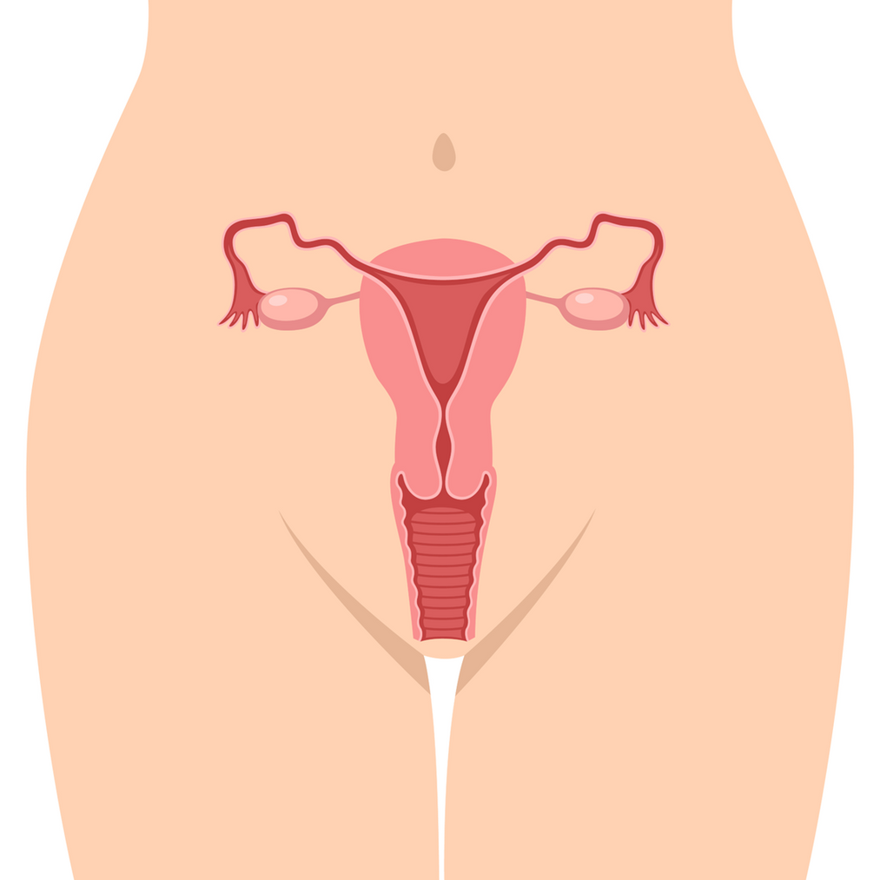
Period Education
UK
Q.1 What is menstruation?
uterus
ovary
(Also known as a period)
uterus lining
Menstruation is the proper medical term, but it is commonly known as periods. ​
​
Periods are part of the menstrual cycle where the uterus (found in the pelvis) lining sheds and blood and some uterus tissue flows down through the cervix and out of the vagina.
Cervix
vagina

Slide 9
Period Education
UK
Q.2 What names have you heard people use when talking about menstruation or periods? ​
There are more than 5,000 different words for periods across the world!​
​
These have been used because in the past people were ashamed of talking about periods.
Watch this! https://youtu.be/R0QAo-niepk

Slide 10
Period Education
UK
Q.3 Why do people have periods?
Watch this!
Notes:
https://youtu.be/ulaPA-zZ9OI

Slide 11
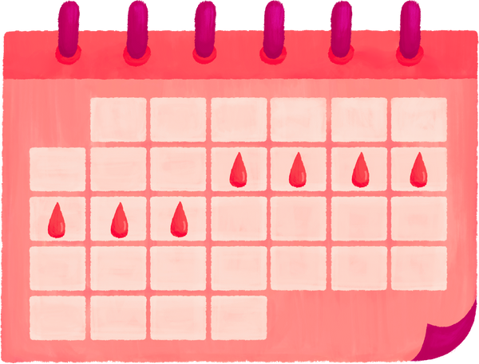
Period Education
UK
Q.4 What's the difference between menstruation and the menstrual cycle?
A period is only one part of the menstrual cycle where the uterus lining sheds and comes out of the vagina as blood.
​
A menstrual cycle is the length of time from the start of one period to the start of the next period. ​
Day 1 of the cycle is the first day of bleeding (known as period, menstruation or menses)

Slide 12
Period Education
UK
WHAT TO EXPECT AND WHAT'S NORMAL

Slide 13
Period Education
UK
QUESTIONS
​1. At what age does the menstrual cycle start?​
​
2. At what age does menstruation stop?​
​
3. How does someone know when their menstrual cycle will start?​
​
4. What are the first periods like?
What to expect and what’s normal?

Slide 14
Period Education
UK
Q.1 At what age does the menstrual cycle start?
Most people first start their periods anytime from 8-15 years.
The average age is 12 years. ​
If a female has reached their 16th birthday and hasn’t started menstruating then chat with a doctor.

Slide 15
Period Education
UK
Q.2 At what age does menstruation stop?
The average age menstrual cycles stop (menopause) in the UK is aged 51 years, but before then there can be years of irregular cycles (perimenopause).

Slide 16
Period Education
UK
Q. 3 How does someone know when their menstrual cycle will start?
They won’t know for certain. However, periods can start about 2-3 years after breast tissue starts growing.

Slide 17
Period Education
UK
Q.4 What are the first periods like?
The first menstrual cycles are varied in length and flow.​
The first few periods may be very light and only see a few spots of reddish brown blood. ​
It may only last a few days. ​

Slide 18
Period Education
UK
QUESTIONS
5. ​What’s a normal cycle length? (i.e. from one period to the next)​
6. How long should a period last?​
7. How much blood should there be?​
8. What should period blood look like?
What to expect and what’s normal?

Slide 19
Period Education
UK
Q.5 What’s a normal cycle length? (i.e. from one period to the next)
For the first 2 years after periods start, the cycle may be irregular and typically between 21 and 45 days. The first cycle is usually the longest.​
​
By the third year of having periods, most menstrual cycles are on average 28 days but between 21 and 35 days is normal. ​
If a female consistently has a menstrual cycle shorter than 21 days or more than 35 days, or have had no periods for 3 months of more (and are not using hormonal contraception), they should check with a doctor. ​

Slide 20
Period Education
UK
Q.6 How long should a period last?
Most menstruating people will bleed for 2–7 days during their first periods. ​
After 2-3 years, the average period lasts about 5 days but this can vary between 3-7 days. ​
If bleeding is less than 2 days or greater than 7 days then speak to a doctor.

Slide 21
Period Education
UK
Q.7 How much bleeding should there be?
Bleeding is often heavier in the first few days of the period​.
Using three to six ‘regular’ pads or tampons per day is normal.​
​
Excessive bleeding includes:
Changing period products every 1–2 hour, particularly if bleeding lasts more than 7 days
Needing to use two period products at one time (e.g. pad and tampon)
Frequently leaking through period products
Passing clots the size of 10p coin.

Slide 22
Period Education
UK
Q.8 What should period blood look like?
Changes in period blood colour are normal​.
​Bright red, dark red, brown, or black period blood is all normal
Watch this!
https://www.youtube.com/watch?v=w6MzSW-8034

Slide 23
Period Education
UK
SYMPTOMS

Slide 24
Period Education
UK
QUESTIONS
1. ​Does everyone experience the same symptoms?
2. What symptoms have you heard of?
Symptoms

Slide 25
Period Education
UK
Q. 1 Does everyone experience the same symptoms?
Physical and mental menstrual cycle symptoms are very common​.
​
Many people use the term Premenstrual Syndrome (PMS) to describe the symptoms they experience in the time leading up to a period and the first couple of days of a period.​
​
However, in reality, different symptoms (good and bad) can occur across the menstrual cycle.

Slide 26
Period Education
UK
Q. 1 Continued
Experiences of the menstrual cycle are very individual and empathy is key to helping menstruating people. One person can have very few and mild symptoms and another can have a number of symptoms and might struggle to manage them.​
​
If symptoms are not manageable (we’ll talk about management in the next session) and affecting daily life then get help from a medical professional.

Slide 27
Ill/cold symptoms
Period Education
Irritable/agitated
UK
Poor control
Constipation
Headache
Worry/anxiety
Dizziness
Sick/nausea
Abdominal pain
Heavy bleeding
Distracted/emotional
Reduced motivation
COMMON MENSTRUAL RELATED SYMPTOMS
Bloating
Backache
Bad skin
Changes in appetite/
food craving
Clumsiness/​
reduced​
coordination
Fatigue/tiredness
Weight changes
Mood swings
Reduced recovery
Diarrhoea
Trouble sleeping
Breast pain/change size
Poor temperature regulation

Slide 28
Period Education
UK
Increased concentration
Improved recovery from exercise
Energetic
IT’S NOT ALL NEGATIVE! PEOPLE EXPERIENCE POSITIVE SIGNS AT CERTAIN TIMES IN THEIR CYCLE
Strong
Good skin
More focused
Confident
Reduced recovery
Good sleep
More co-ordinated
Happy

Slide 29
Period Education
UK
SUMMARY
The menstrual cycle may be irregular and typically between 21 and 45 days for the first two years.
They are then on average 28 days (between 21 and 35 days is normal)
Average of 5 days bleeding (between 3-7 days is normal)
Changes in period blood colour are normal​ - bright red, dark red, brown, or black
People have different menstrual cycle experiences with different symptoms

Slide 30
Authors ​and contributions:
Content developed by Dr Laura Forrest*, Dr Natalie Brown and Beky Williams.
Associated activities co-designed by Dr Laura Forrest, Dr Natalie Brown, Beky Williams, Dr Shirley Gray, Elaine Wotherspoon, Julie Isdale, Tilly O'Donnell.
Valuable feedback received from Megan Padden, Tracy Johnston, Dr Jessica Piasecki and Dr Georgie Bruinvels.
*Dr Laura Forrest was supported by the Royal Society of Edinburgh Research Fellowship during the development of these resources
​
Period Education ©2023 (www.periodeducation.org)​
All rights reserved. These resources may be reproduced by anyone working to promote the menstrual health of women and girls as long as it is clearly referenced. It may not be used for commercial purposes unless written permission has been obtained from Period Education. ​

