Slide 1
Period Education
UK
Managing Menstruation: Period Products
Session 2

Slide 2
Period Education
UK
SESSION AIMS
To identify different period products
To increase understanding in how to use period products
To increase awareness of factors affecting period product choice

Slide 3
Period Education
UK
Introduction
Period products collect or absorb the blood that is shed from the uterus lining during a period.
Some period products are worn outside of the body and others are placed inside the vagina to absorb/collect blood.
Some period products are thrown away after use and others are reusable.
Period product choice has improved a lot over recent years!

Slide 4
Period Education
UK
COMMON PERIOD PRODUCTS​

Slide 5
Period Education
QUESTIONS
UK
1. What do you know about the period products displayed?
2. How do you use period products?
Look at the period products displayed
Notes:
You will need

Slide 6
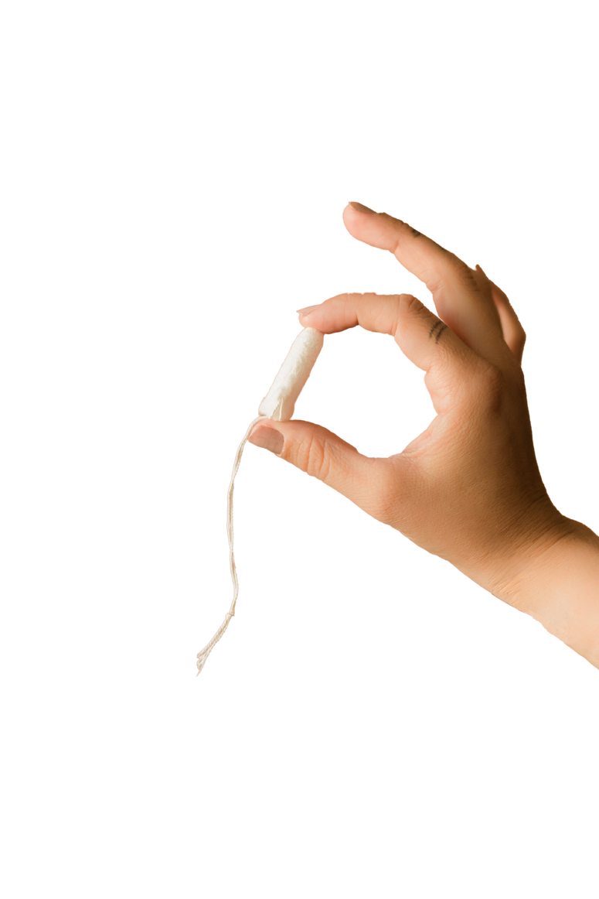
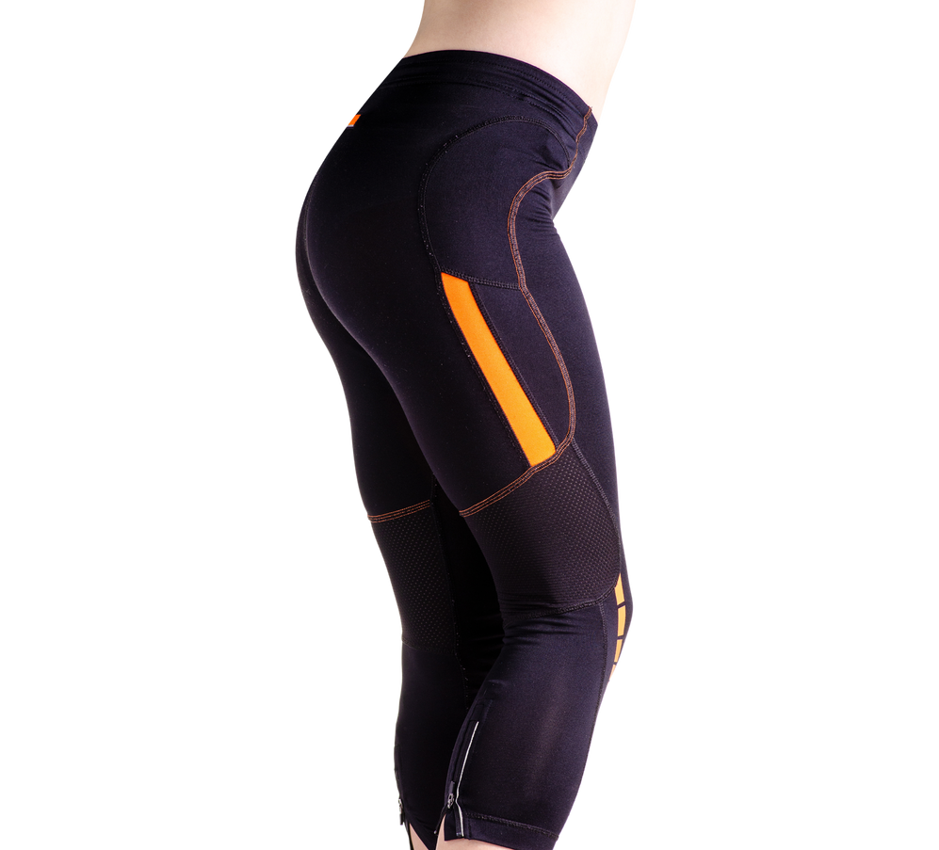
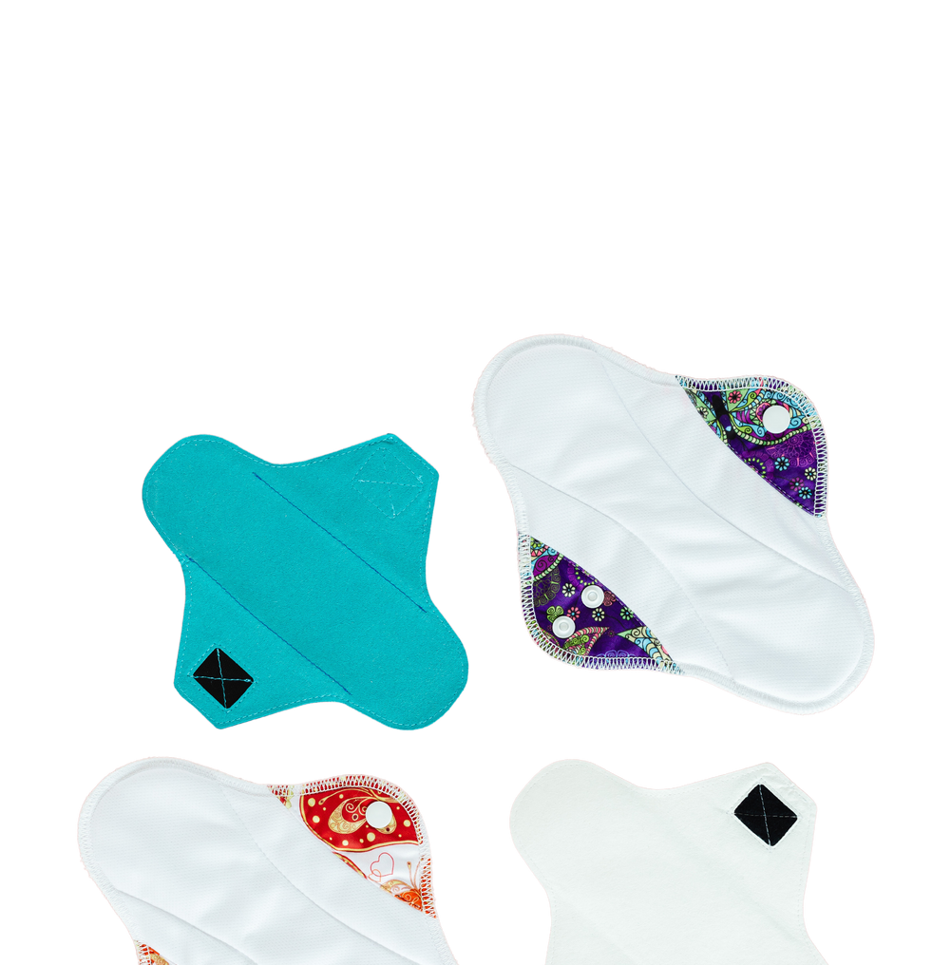
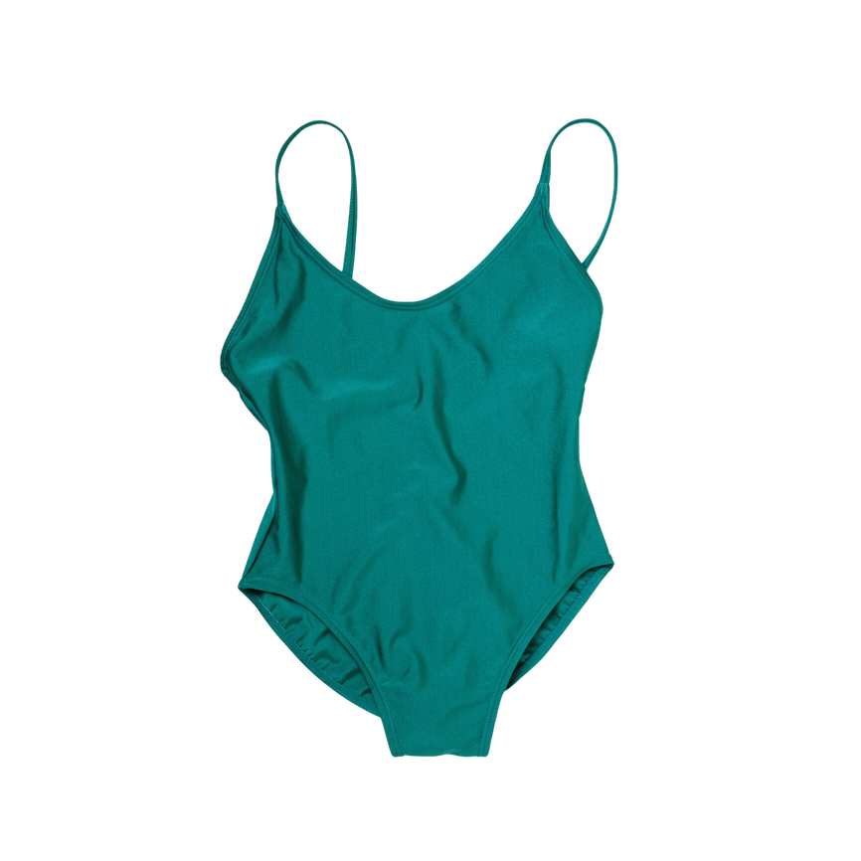
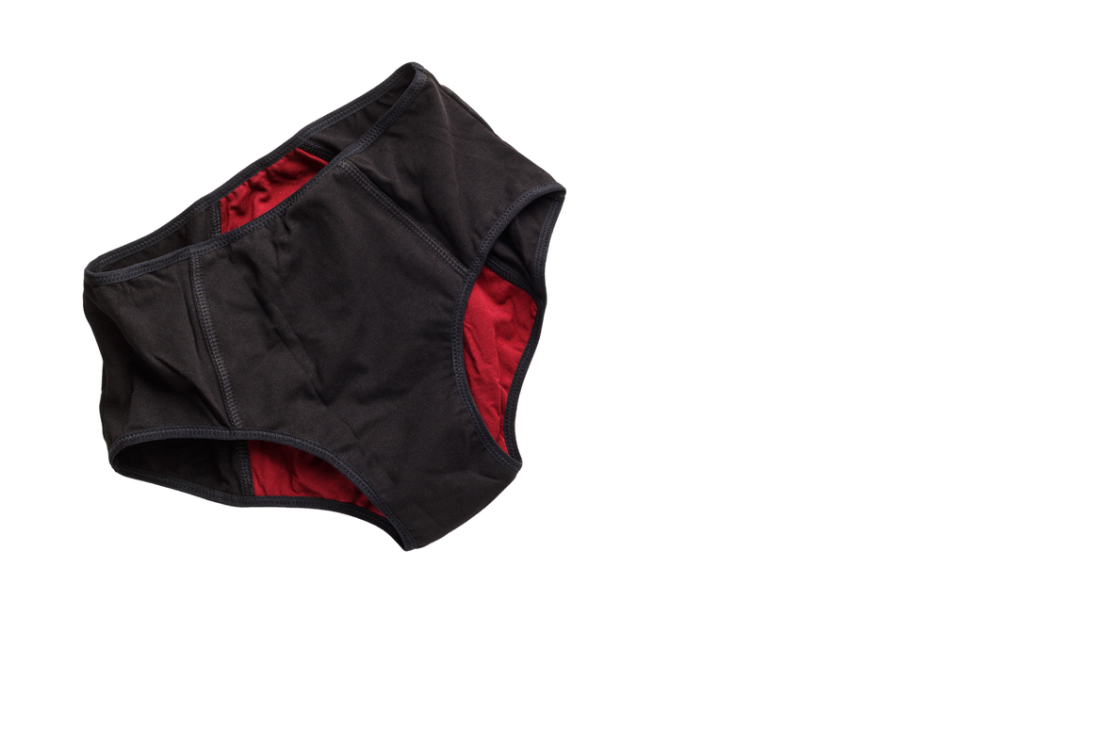
Period Education
UK
Q.1 What do you know about the period products displayed?
Pads (disposable and reusable)
Tampons
Menstrual Cups
Reusable Period Pads
Period pants
Period Swimwear
Period Activewear e.g. leggings

Slide 7
Period Education
UK
Q.2 How do you use period products?
Period Pads, Tampons and Menstrual Cups ​
Watch this video for a brief overview of disposable pads, tampons and menstrual cups
https://www.youtube.com/watch?v=D_XeQqIX8gk

Slide 8
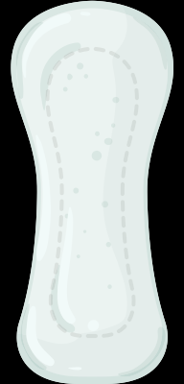
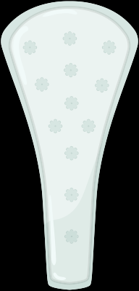
Period Education
UK
Q.2 How do you use period products?
Disposable period pads in more detail
4-8
They come in different absorbencies, sizes, styles, and thicknesses.
Some pads have material on the sides called "wings“ that fold over the edges of underwear to help secure the pad.
Some girls wear panty liners when flow is very light, or during non-period days when there’s more vaginal discharge.
Change pads every 4-8 hours
Never flush a disposable pad down the toilet. They end up in our water systems and oceans!

Slide 9
Period Education
UK
Q.2 How do you use period products?
Tampons in more detail
Menstruaters are usually unsure and sometimes fearful of using and inserting tampons for the first time. Watch this video for instructions.
https://www.youtube.com/watch?v=PnGITvOKBXY

Slide 10
Period Education
UK
Q.2 How do you use period products?
How to use tampons in more detail
4-8
Use the lowest absorbency tampon needed
Change tampon at least every 4-8 hours. Never wear a tampon for more than 8 hours
Never flush a disposable tampon down the toilet. They end up in our water systems and oceans!
Notes:
Teacher notes: Toxic Shock Syndrome (TSS) is a rare but serious illness which is linked to wearing tampons for longer than 4-8 hours. Symptoms include having flu-like symptoms, a rash, a fever, feeling dizzy and sick.
If a tampon is left in longer, don't freak out! It's probably fine, but if there are TSS symptoms, see a doctor right away.

Slide 11
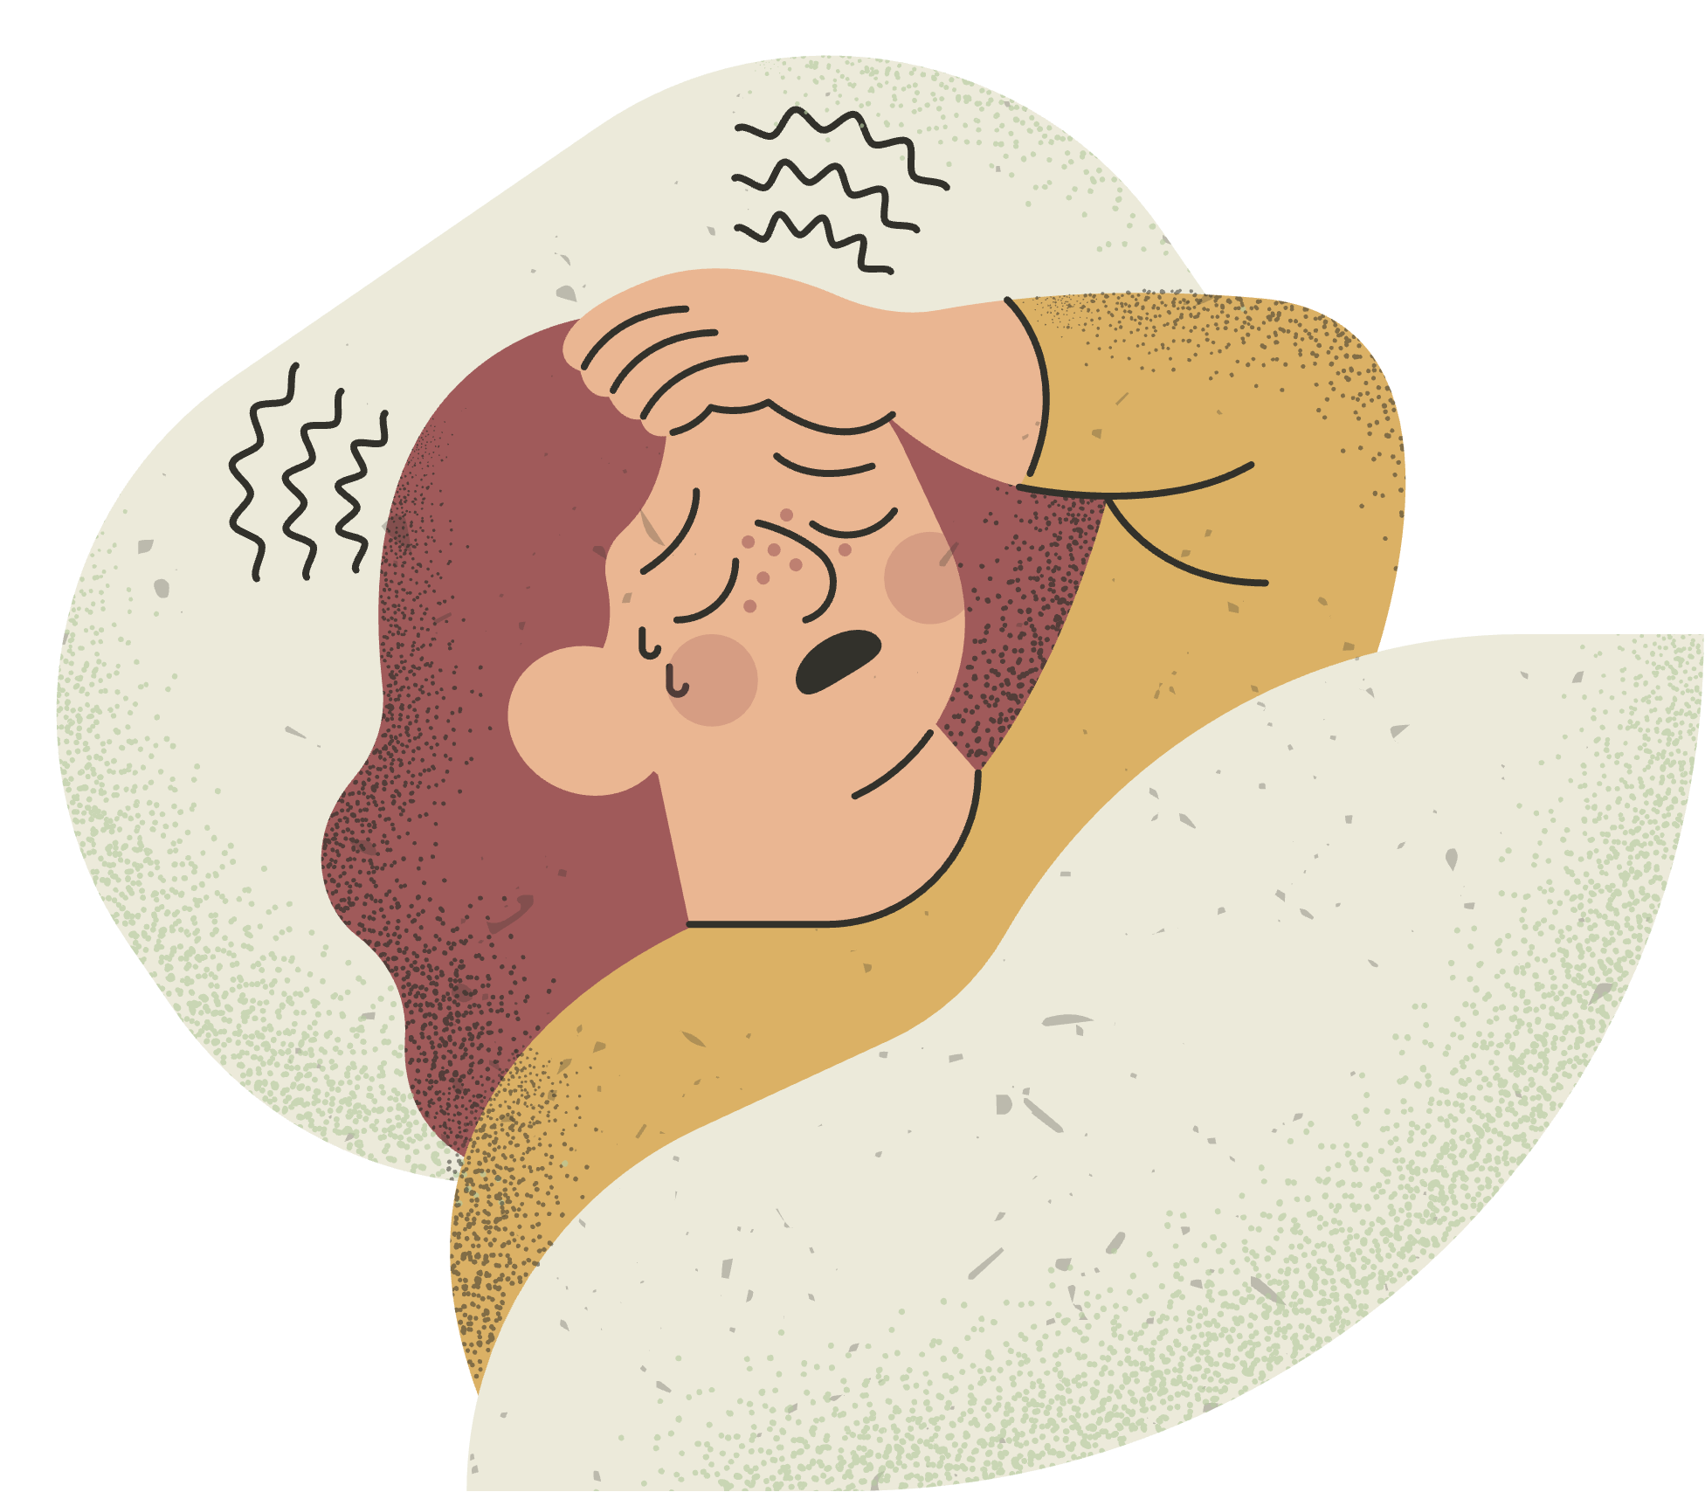
Period Education
UK
Q.2 How do you use period products?
Tampons in more detail
Toxic Shock Syndrome (TSS) is a rare but serious illness which is linked to wearing tampons for longer than 4-8 hours. Symptoms include having flu-like symptoms, a rash, a fever, feeling dizzy and sick.
If a tampon is left in longer, don't freak out! It's probably fine, but if there are TSS symptoms, see a doctor right away.

Slide 12
Period Education
UK
Q.2 How do you use period products?
Menstrual cups in more detail ​
Watch this video for instructions on how to use a menstrual cup.
https://youtu.be/I5KCYXDddzc
Rinse with clean water after emptying and re-inserting the cup. If in a public toilet, bring a bottle of water.
After your period finishes soak, in boiling water for 5-7 minutes.

Slide 13
Period Education
UK
Q.2 How do you use period products?
Reusable Period Pads, Pants, Swimwear and Activewear
Made of soft absorbent layers of material which collects menstrual blood. They can be made of different material.
Come in different absorbencies, sizes, styles, and thicknesses as well as colours and designs.

Slide 14
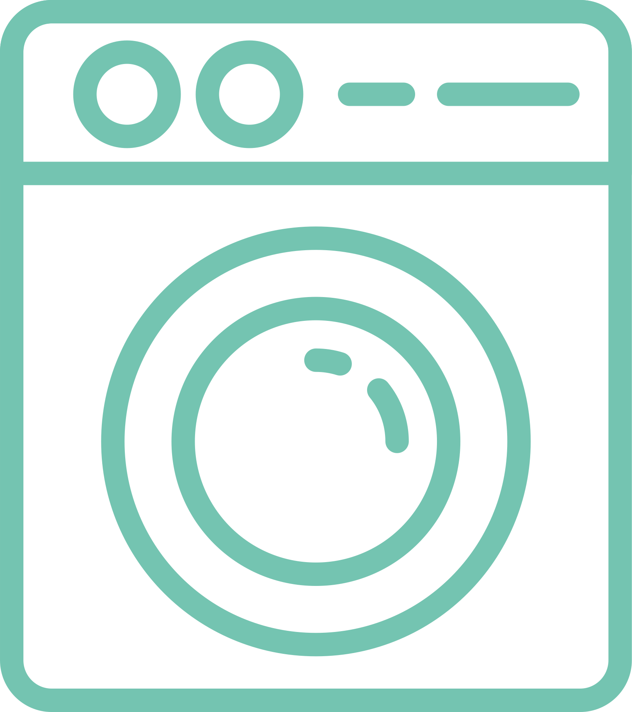
Period Education
UK
Q.2 How do you use period products?
Reusable Period Pads, Pants, Swimwear and Activewear
4-8
8-12
How long you can wear them varies. Some retailers say 4-8 hours whilst others say 8-12 hours.
Changes may be needed more frequently on heavier days
Reusable pads often come with a pouch to carry them in when not using them or to store them until you get home to wash them.
Often need to rinse or soak them in cold water after use, then put in a cool wash. Hang to dry and then reuse!

Slide 15
Period Education
UK
MAKING PERIOD PRODUCT CHOICES

Slide 16
Period Education
CASE STUDIES
UK
What are the factors to consider before choosing period products?
Case study 1: Izumi has a choice to go swimming or take part in gymnastics today but is currently on her period and is unsure what period products to use for either activity. Can you help?
Case study 2: Today Charlie has a presentation at school, they are worried about standing in front of the class as it is day 2 of their period which means heavy bleeding and worry about leaking. Charlie is also worried if anyone might be able to tell they are on their period. What products might help Charlie?
Case study 3: It is school sports day, Shahin is on her period and is worried about being able to change her menstrual product during the day as access to toilets is difficult. What options might be best for her?

Slide 17
Period Education
UK
What are the factors to consider before choosing period products?
4-8
8-12
Financial cost
Environmental impact
Absorbency
(how much blood it can hold)
Availability
How long the product can be worn before changing
Family tradition of using a certain type of product
Ease of use
Suitability for activities
Comfort

Slide 18
Period Education
UK
Availability - Free Period Products
As of 2022, all schools in the UK should have access to free period products to give to pupils.
There is no need to be embarrassed taking these products - they are there to help all menstruating young people.

Slide 19
Period Education
UK
SUMMARY
There are different products available to suit all menstruators, including reusable and disposable period pads, tampons, menstrual cups, period pants, period swimwear and activewear.
Each product collects or absorbs blood in a different way
Each product has its own care and hygiene instructions
There are different factors affecting period product choice, including availability, absorbency, how long they can be worn before changing, ease of use, comfort, financial and environmental cost, suitability for activities and family traditions.

Slide 20
Period Education
UK
Disposable Pads - Pros and Cons
Easy to use
Relatively cheap to buy
Different sizes, absorbencies and styles
Environmental impact – most pads are made from 90% plastic
Need to buy a lot over time
Can’t wear them whilst swimming
If doing lots of activity, they may move around a little
Often not as comfortable as other forms

Slide 21
Period Education
UK
Reusable Pads - Pros and Cons
Easy to use
Different sizes, absorbencies, colours and designs
Environmentally friendly – they last approximately 5 years depending on what you buy
Are often more comfortable than disposable pads
The initial cost is higher than disposable products
Can’t wear them whilst swimming
Need to store them and take them home to wash.
Sometimes if doing a lot of activity, the pads can move slightly

Slide 22
Period Education
UK
Tampons
Relatively cheap to buy
Different absorbencies
Comfortable – shouldn’t be able to feel them
Can wear during swimming!
Takes a bit of practice to master it but is easy and convenient when you have
Environmental impact – some tampon applicator and wrappers are made from plastic
Need to buy a lot over time so cost add over time

Slide 23
Period Education
UK
Menstrual Cups
Different sizes (based on age and whether you’ve had a baby and not menstrual flow)
Environmentally friendly – they last approximately 5-10 years depending on what you buy
If inserted properly, you can’t feel the product
Can wear it whilst swimming
Can wear it longer than some other products (12 hours)
It can take some practice to get used to inserting the product
It can be a bit messier when removing than other products as blood will go on your hands
The initial cost is higher than most other products
Need to rinse it after emptying and may not have a sink in a public toilet cubicle

Slide 24
Period Education
UK
Period Pants
Easy to use
Different sizes, absorbencies, colours and designs
Environmentally friendly – they last approximately 5-10 years depending on what you buy
Are often more comfortable than disposable pads
The initial cost is higher than disposable products or reusable pads
Can’t wear them whilst swimming

Slide 25
Period Education
UK
Period Swimwear
Can be worn swimming and doing other water sports!
Easy to use
Different sizes, absorbencies, colours and designs
Environmentally friendly – they last approximately 5 years depending on what you buy and how often they are worn
The initial cost is higher than normal swimwear
May not be as good for heavy flow.

Slide 26
Authors ​and contributions:
Content developed by Dr Laura Forrest*, Dr Natalie Brown and Beky Williams.
Associated activities co-designed by Dr Laura Forrest, Dr Natalie Brown, Beky Williams, Dr Shirley Gray, Elaine Wotherspoon, Julie Isdale, Tilly O'Donnell.
Valuable feedback received from Megan Padden, Tracy Johnston, Dr Jessica Piasecki and Dr Georgie Bruinvels.
*Dr Laura Forrest was supported by the Royal Society of Edinburgh Research Fellowship during the development of these resources
​
Period Education ©2023 (www.periodeducation.org)​
All rights reserved. These resources may be reproduced by anyone working to promote the menstrual health of women and girls as long as it is clearly referenced. It may not be used for commercial purposes unless written permission has been obtained from Period Education. ​

