Slide 1
Period Education
UK
Staying Active During PE(riods)!
Session 4

Slide 2
Period Education
UK
SESSION AIMS
Identify the benefits of exercise for the menstrual cycle and period symptoms
Identify different physical activity and exercises that have been shown to improve menstrual cycle symptoms
Identify ways to engage in PE whilst menstruating

Slide 3
Period Education
UK
EXPERIENCES AND IMPORTANCE OF EXERCISE FOR THE MENSTRUAL CYCLE

Slide 4
Period Education
Exercise and physical activity should be minimised whilst menstruating
Females can swim whilst on their period
3. Athletic performance will decline when menstruating and there’s nothing that can be done about it
A menstrual pad can be used when exercising
Inversion exercises (e.g. downward dog, headstands, handstands) should be avoided when menstruating
Females tire more easily during exercise when on their period
It is normal for periods to stop or become less frequent if females train or work out a lot
UK
Frequently Asked Questions or

Slide 5
Period Education
UK
Exercise and PE(riods)
Staying active is super important
The mental, physical and social benefits of physical activity, exercise and sport are well-known.
Q. What are the benefits of physical activity, exercise and sport?
The physical activity recommendations is 60 minutes per day for long-term health.
~45-65% of girls aged 13-16 years do not meet the minimum physical activity recommendations (Sport England, 2022; Welsh Government, 2022).
Q. Do you meet this recommendation?

Slide 6
Period Education
UK
Exercise and PE(riods)
39-78% girls say having their period stops them taking part in sport, physical activity and PE at school or is barrier to PE participation (Women in Sport, 2022; Youth Sport Trust, 2022).
“Some are different than others. Some people can happily skip round and do cartwheels, then some people can hardly move”
“I get really bad pains, last time I was in PE I felt really bad and we were jumping and everything and I only jumped once because of how bad it was”

Slide 7
Period Education
UK
Exercise and PE(riods)
Doing physical activity, exercise and sport whilst on your period can be challenging.
Even elite athletes can find it challenging at times. But it can also make you feel better.
“The only way to describe it is that my legs feel like they have been replaced with concrete blocks … There is still a lot of trial and error in finding what works for each individual, but I personally feel much more educated on the subject than ever before”
Eilish McColgan, 3 x Olympic athlete, 2022
“If I’m on my period, if my tummy is crampy and sore, sometimes if I go into exercise that can make it a bit better”
Elite rugby player

Slide 8
Period Education
UK
Exercise and the menstrual cycle
Fluctuating hormones can influence exercise and performance both positively and negatively.
If symptoms don't cause problems then there is no need to limit exercise during a period. Olympic athletes have won medals whilst on their period!
There may also be times during the menstrual cycle that exercise feels easier.
“When I have a bad period (once every couple of months or so) it can stop me from completing a high intensity session (Intervals etc.), and other sessions will not be as productive (sometimes, [although] rarely, not completed at all) due to cramping and pain”
Elite rugby player
Usually the week before I’m on [my period] … I feel strong in the gym”
elite rugby player

Slide 9
Period Education
UK
Exercise and the menstrual cycle
Watch this video. Go to
https://www.youtube.com/watch?v=Kkk9tKHHt8k
There are a few things that are common (but not for all!) when it comes to experiences.
The week before a period, active people and athletes often say they have increased bloating, feel tired and have low motivation
During a period, stomach cramps, tiredness or feeling 'heavy' the first couple of days of a period is common.
The week after a period, there can be increased energy and motivation for exercise.
Notes:
https://www.youtube.com/watch?v=Kkk9tKHHt8k

Slide 10
Period Education
UK
Exercise and the menstrual cycle
Consistency is key!
Regular exercise (e.g. 3 exercise times per week for 30-60 minutes) can reduce premenstrual symptoms (PMS) and menstrual-related symptoms.
Lots of different types of regular exercise can reduce symptoms, including different aerobic exercise, yoga, pilates, resistance programmes, home-based programmes … there is something for everyone!

Slide 11
Period Education
UK
CONCERNS, BARRIERS AND SOLUTIONS FOR PE AND MENSTRUATION

Slide 12
Period Education
QUESTION
UK
What are/do you think are the general concerns or barriers to participating in PE whilst menstruating?
Exercise and PE(riod concerns)

Slide 13
Period Education
UK
Exercise and PE(riod) concerns
Top concerns menstruating adolescents have about participating in PE or school sport:
1. Pain/discomfort
2. Leaking
3. Low mood
4. Lack of energy
5. Low confidence
6. Self-consciousness in changing rooms
7. Worry others will know they are on their period
(Youth Sport Trust, 2022)

Slide 14
Period Education
UK
Overcoming exercise and PE(riod) concerns
Many of the concerns students have about participating in PE or school sport when menstruating can actually be overcome by exercising or knowing which products might help!
Physical activity, exercise and sport has been shown to reduce:
1. Pain/discomfort
2. Leaking
3. Low mood
4. Lack of energy
5. Low confidence
6. Self-consciousness in changing rooms
7. Worry others will know they are on their period
(Youth Sport Trust, 2022)

Slide 15
Period Education
UK
Overcoming exercise and PE(riod) concerns
1. Pain/discomfort
2. Leaking
3. Low mood
4. Lack of energy
5. Low confidence
6. Self-consciousness in changing rooms
7. Worry others will know they are on their period
(Youth Sport Trust, 2022)
Being prepared will help but there are times we all forget. Ask a PE teacher for period products and don’t be afraid to ask to go to the toilet.
No one but you will know you are menstruating. Try using period pants on days your have PE.

Slide 16
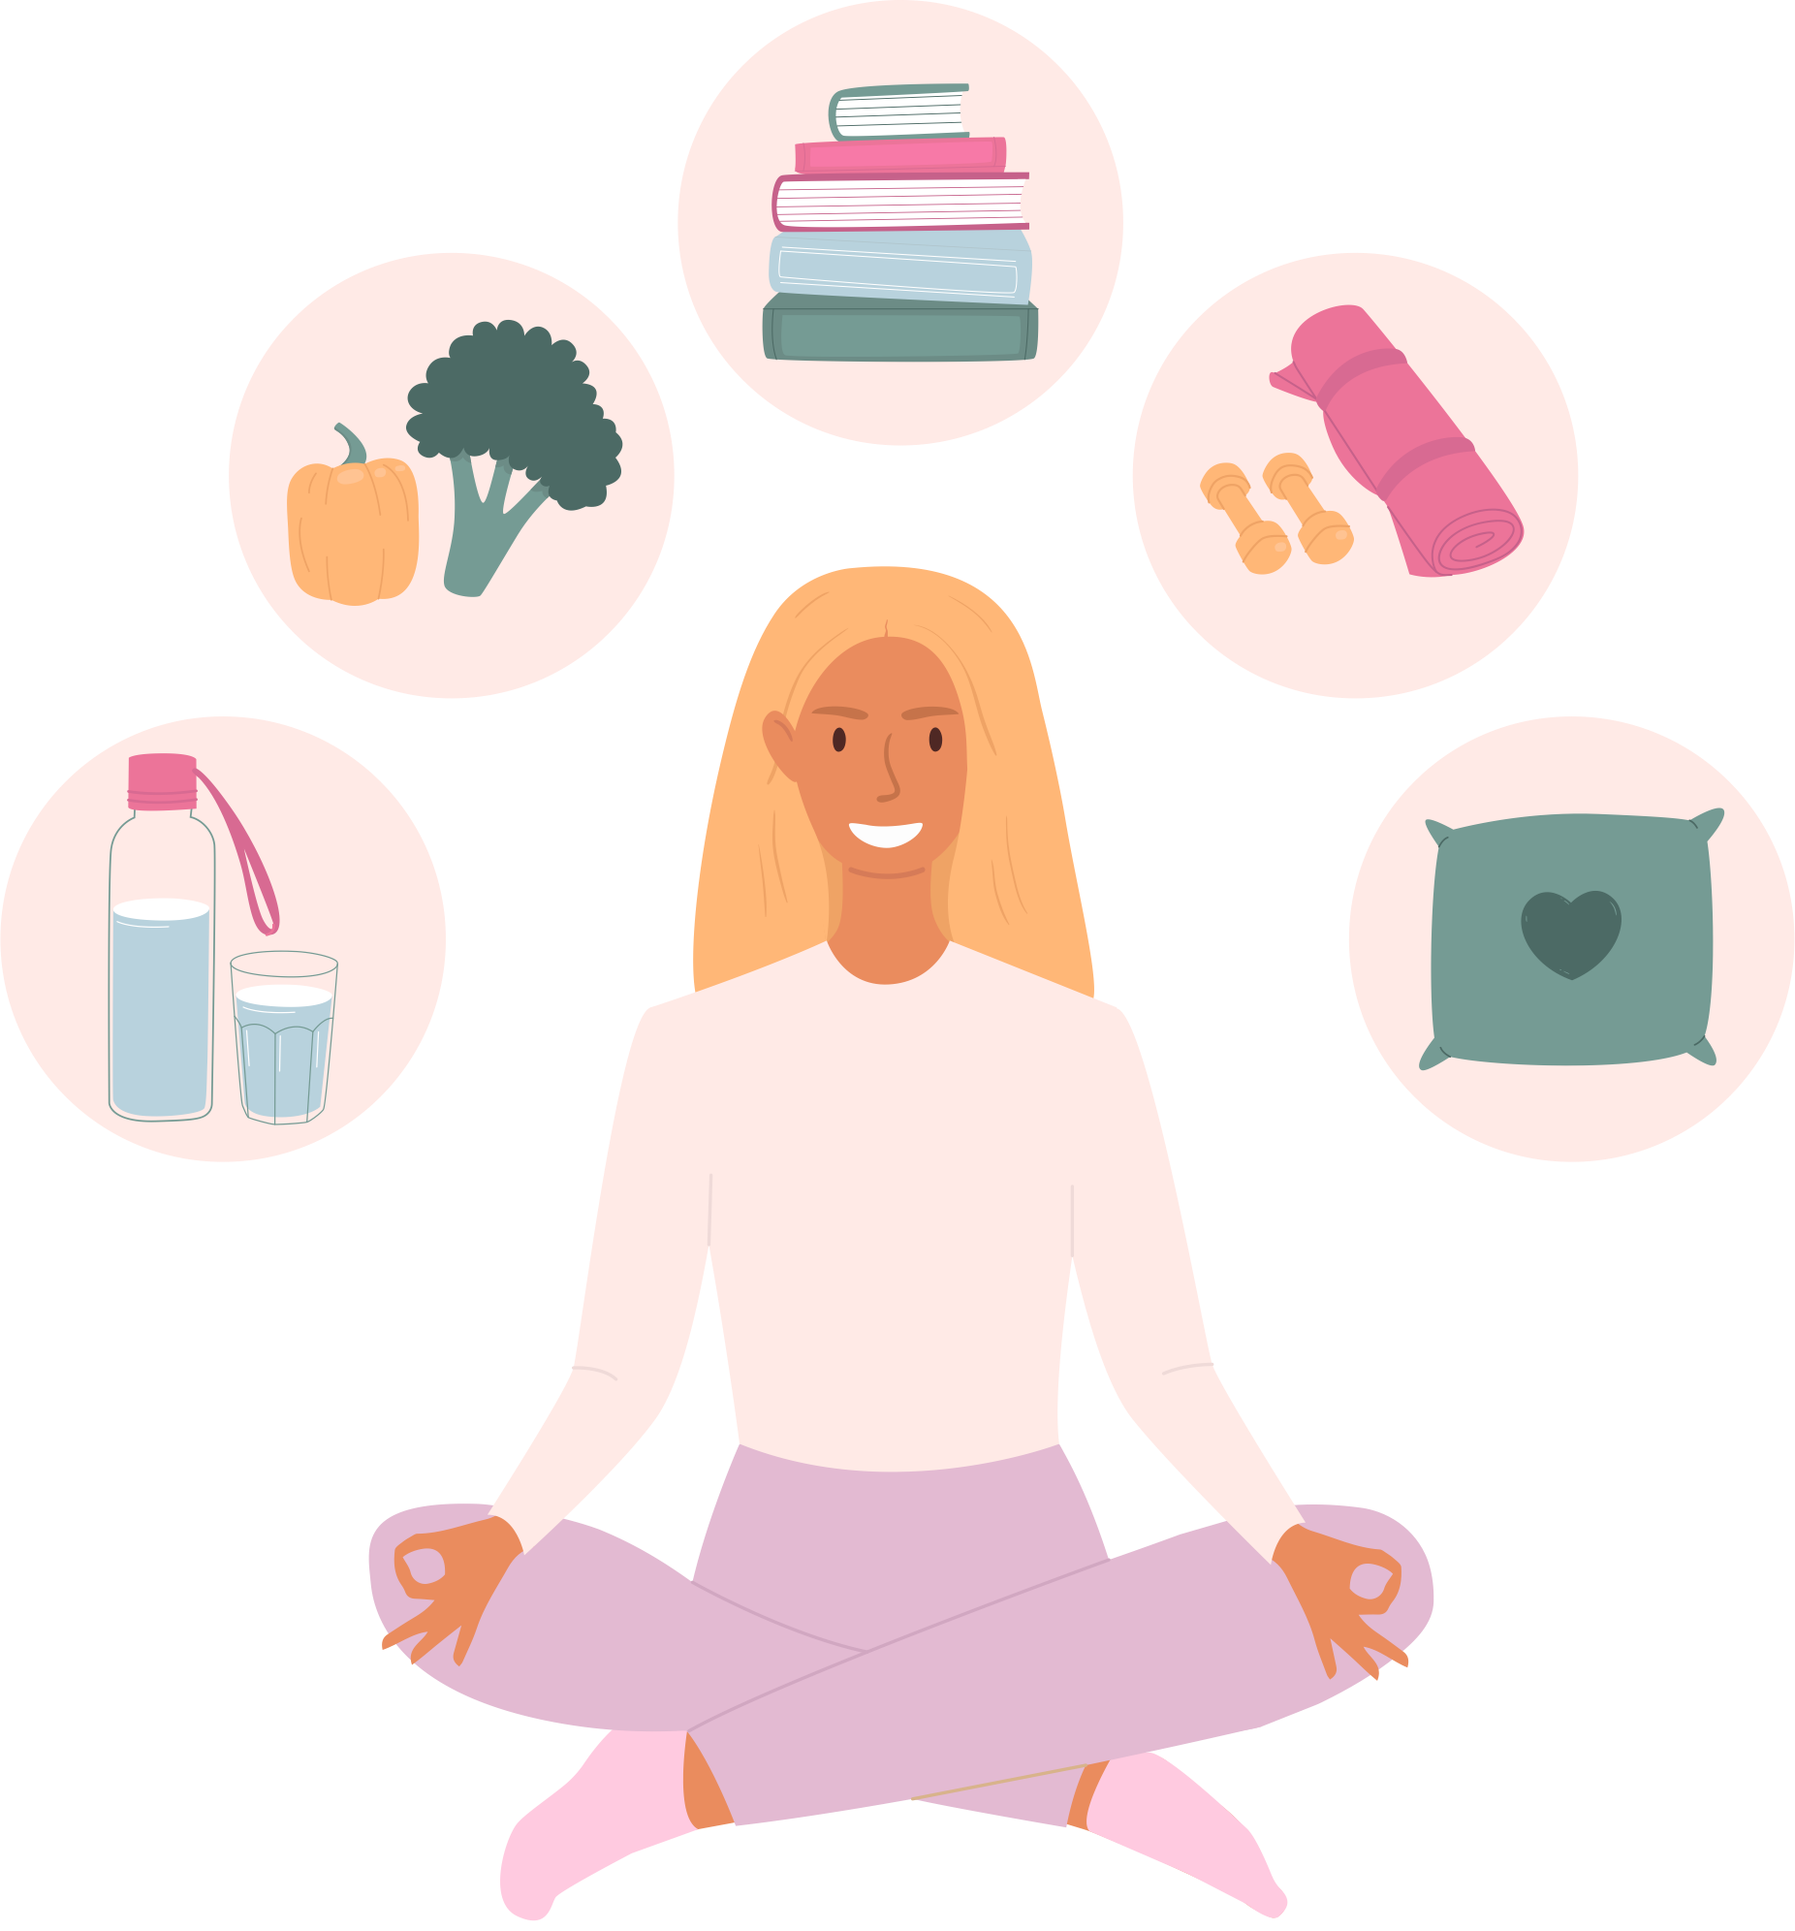
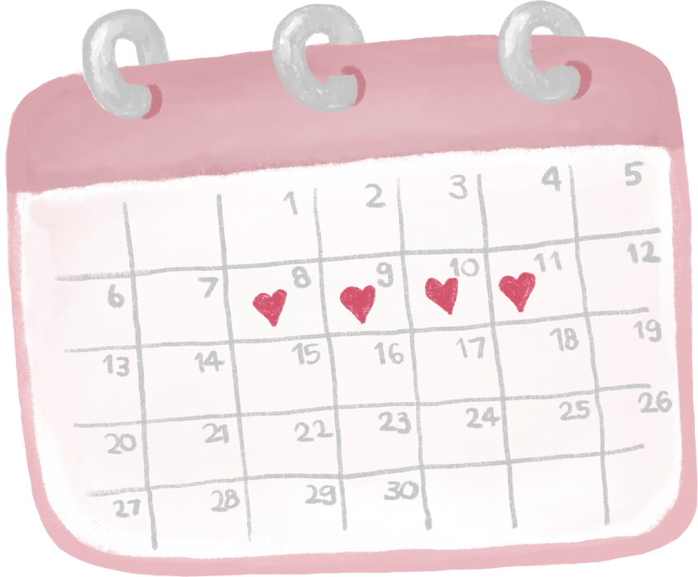
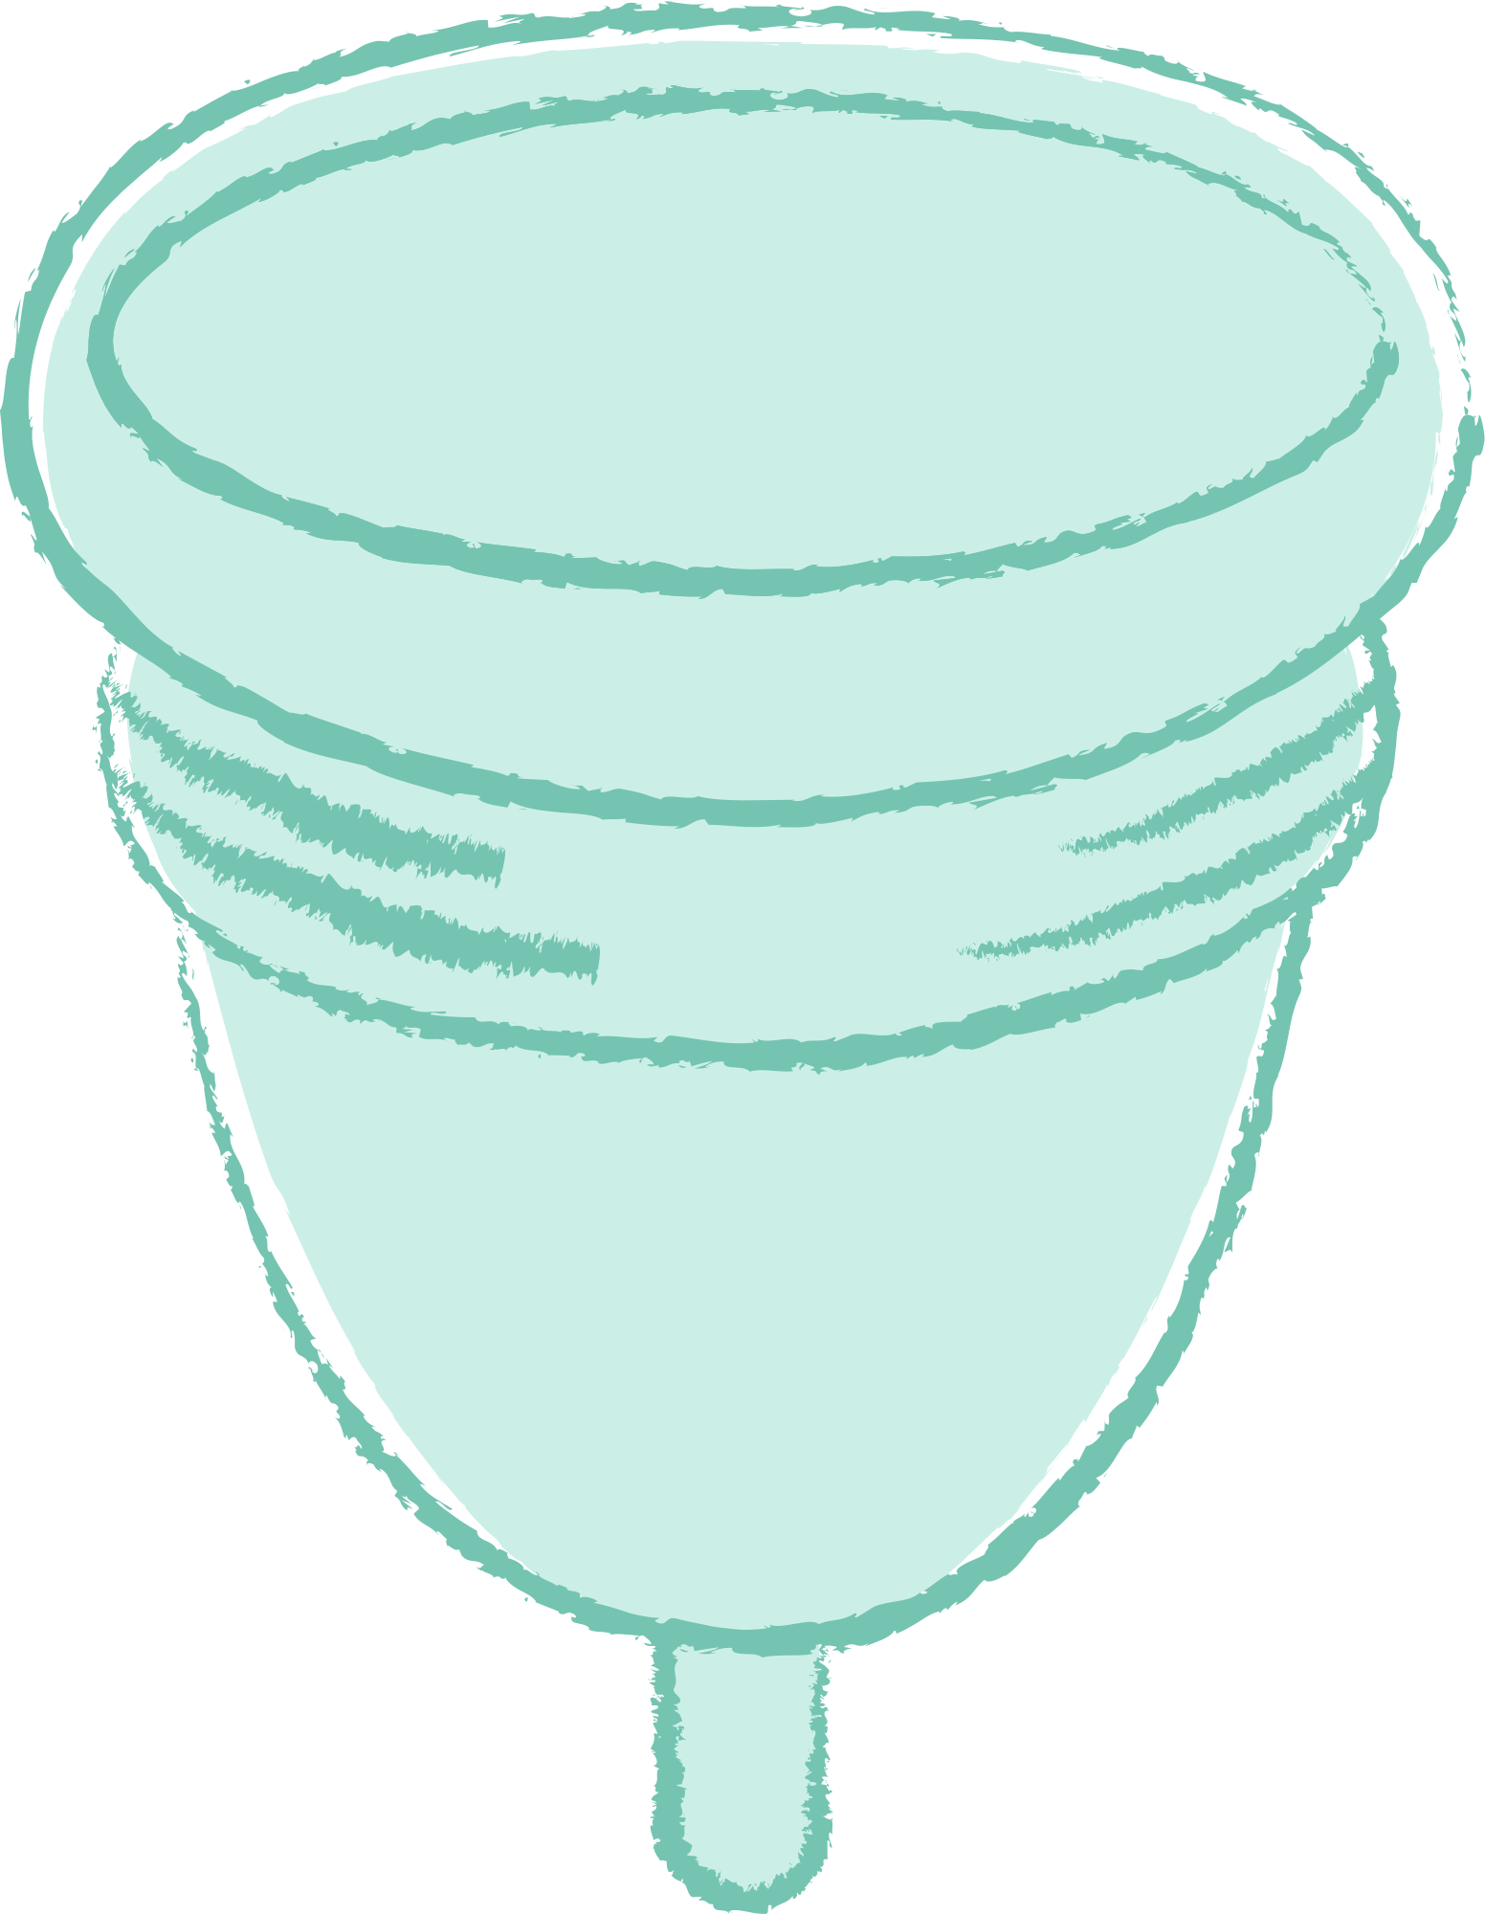
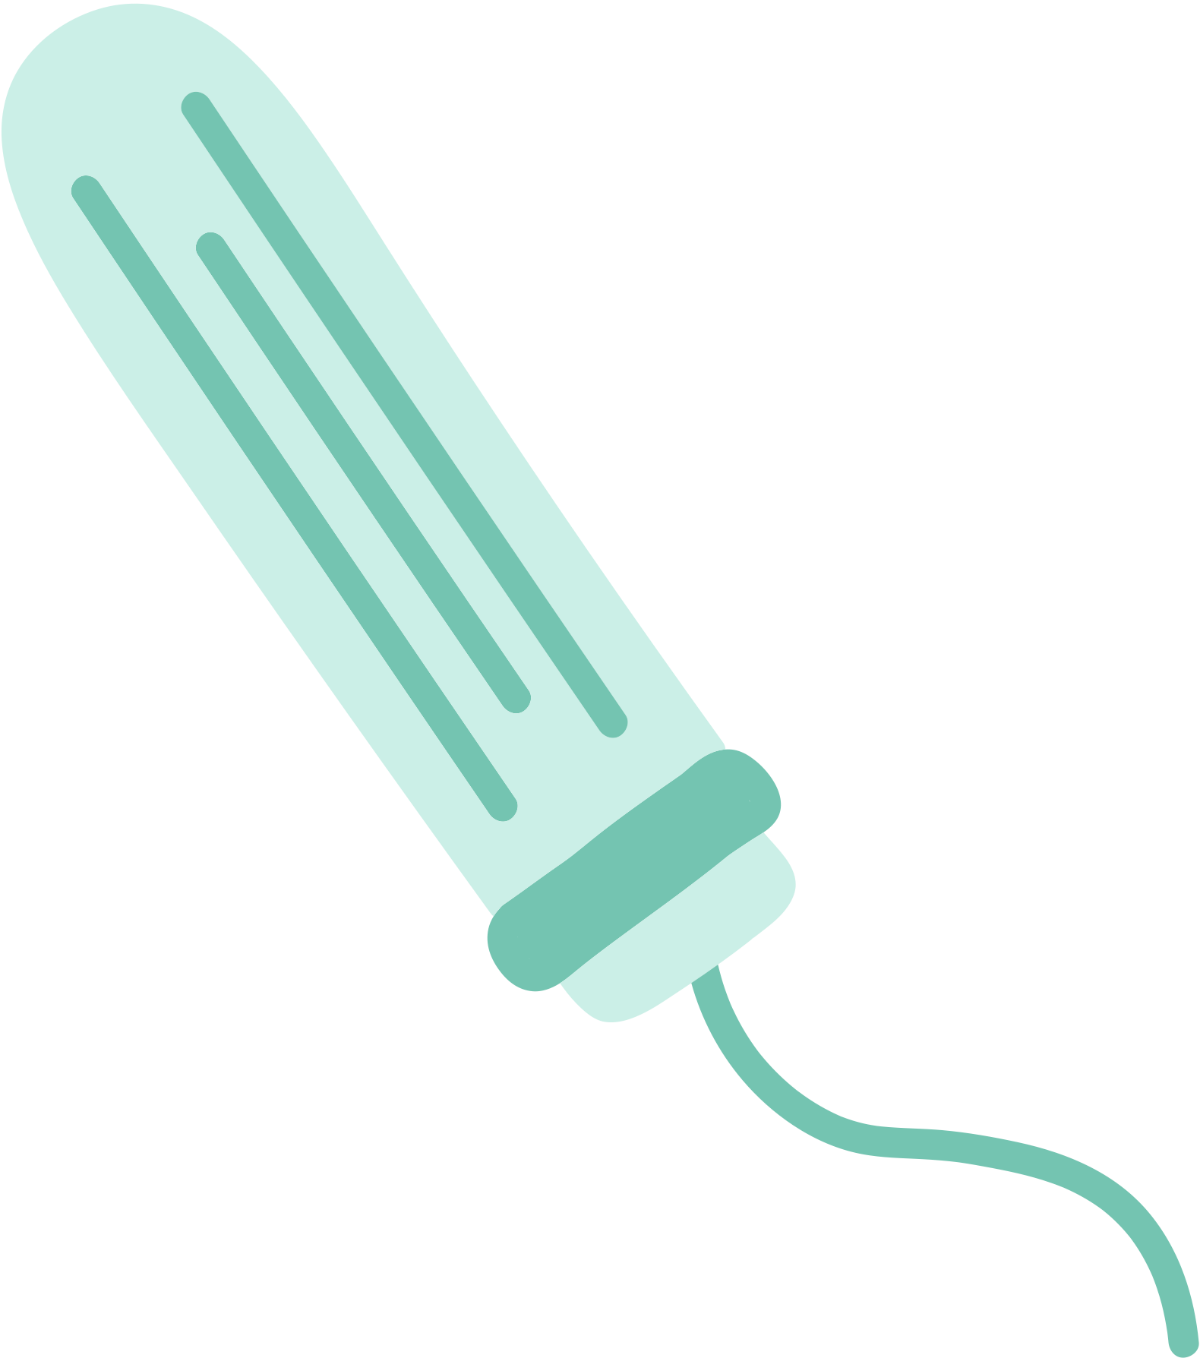
Period Education
UK
Overcoming exercise and PE(riod) concerns
Be prepared
Carry period products or ask for products. Cycles may be irregular to start, or periods may come unexpectedly. Schools should have period products freely available.
Track the menstrual cycle
Tracking your cycle and logging symptoms will help you learn about you. We’ll go into more detail on this.
Be proactive
Try the lifestyle advice to reduce unwanted symptoms. We'll discuss the exercise, physical activity in more detail in the next slides.

Slide 17
Period Education
UK
Taking part in PE during periods
There’s no single best way to exercise during your period. But having options is important.
“There is exercise you can do that reduces pain for periods so maybe if you know rather than saying ‘sit out of PE’ they [PE teachers] can give the girls who are on their period like time to do exercise that helps with cramps or reduces pain”
girl, age X
If I’m not somewhere where I have to perform, well then actually going and doing some exercise [on] day one when I’m crampy helps”
Elite rugby player

Slide 18
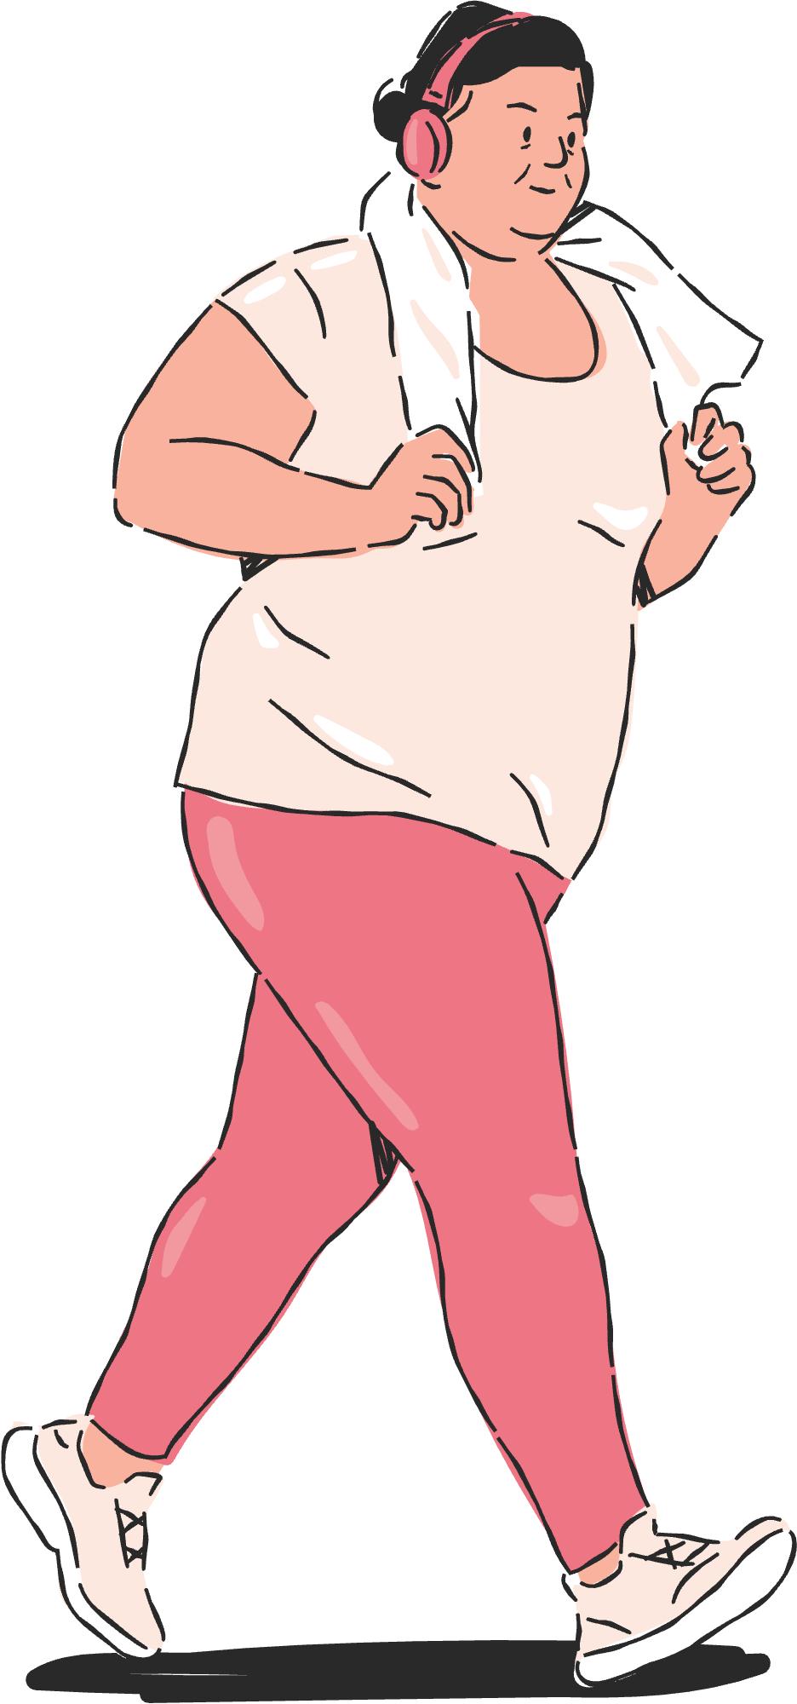
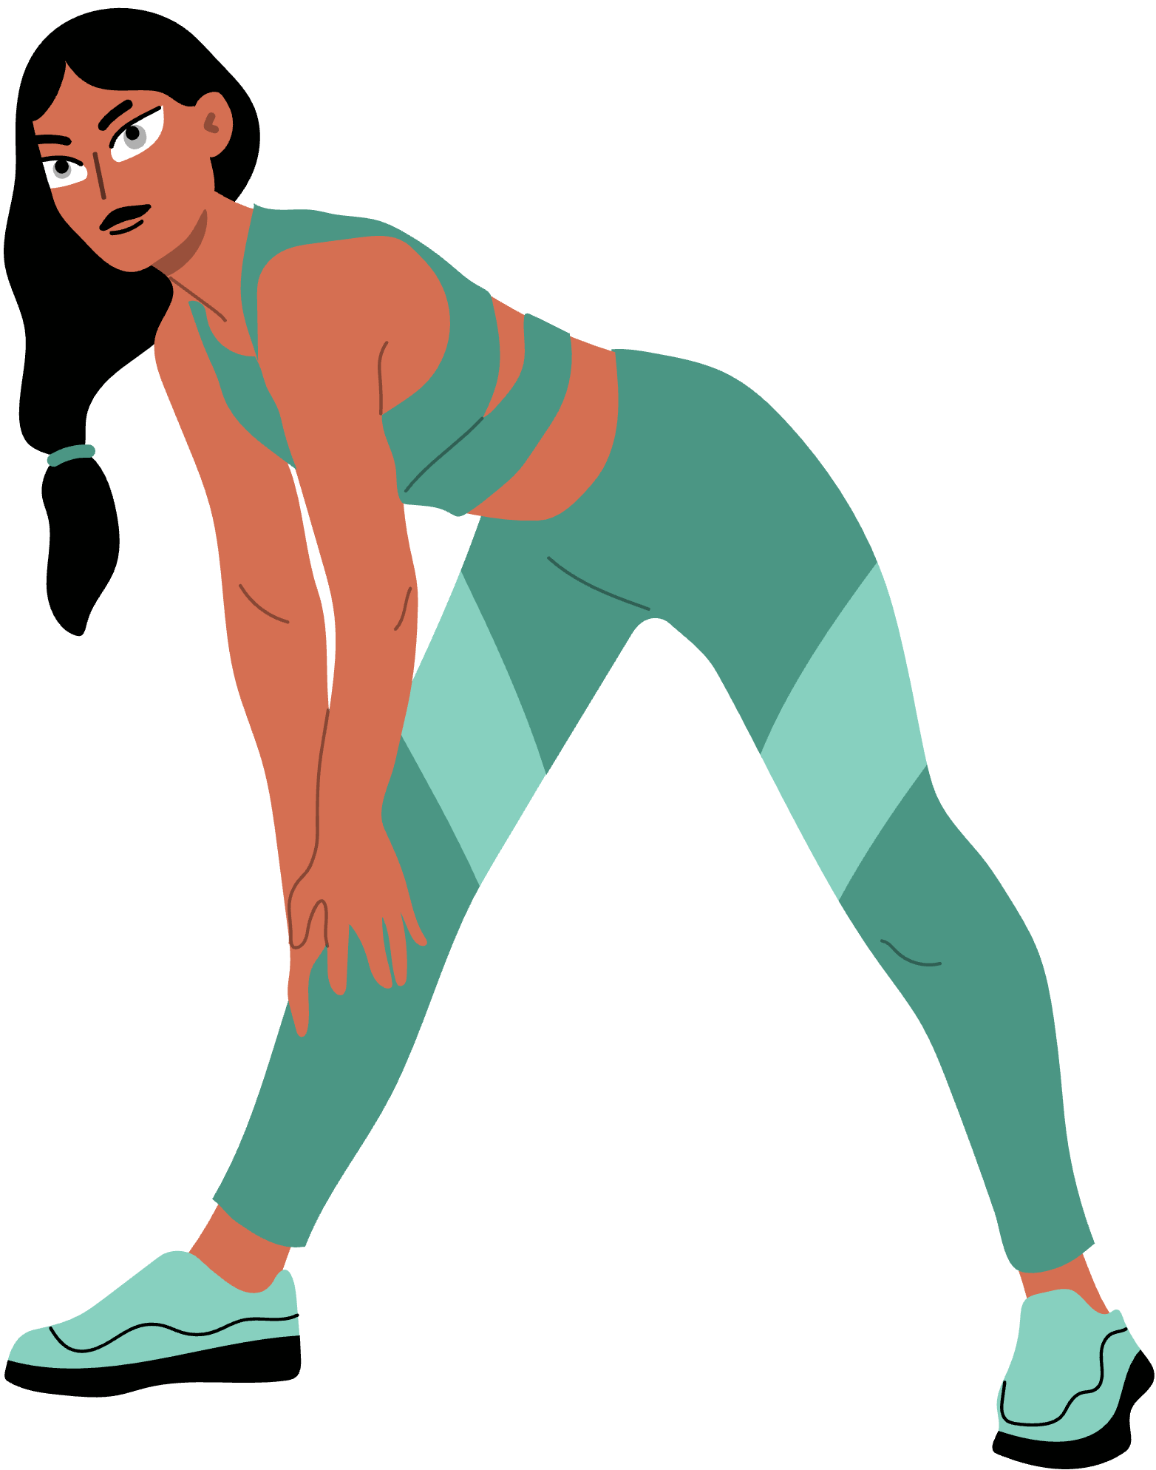
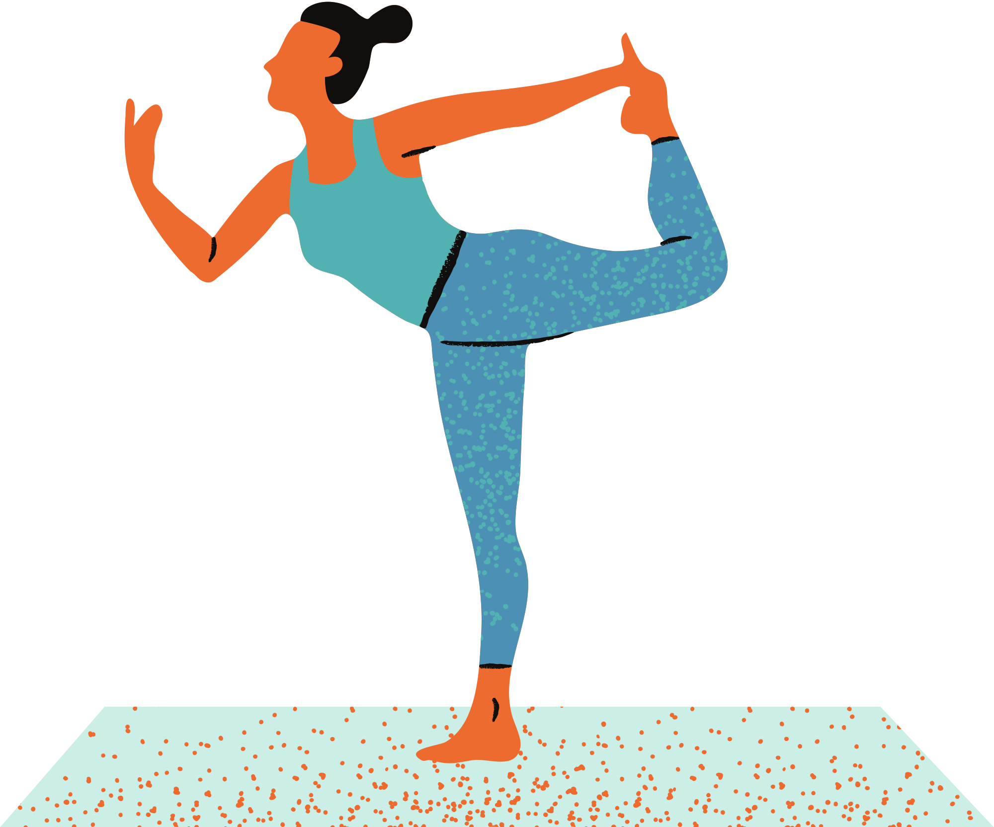
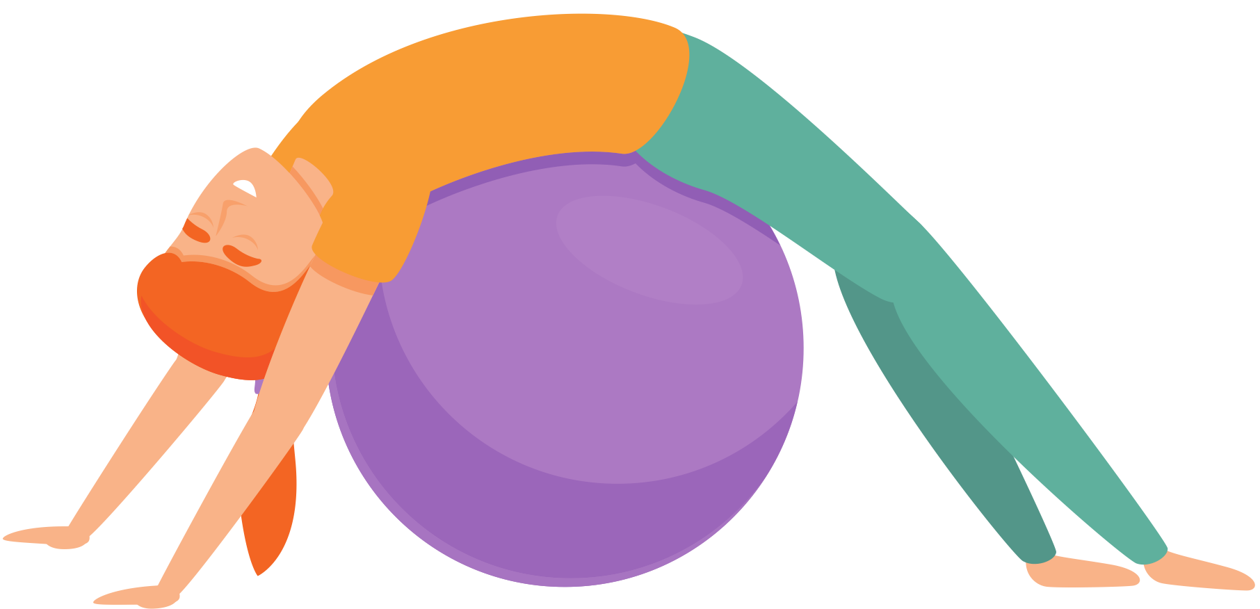
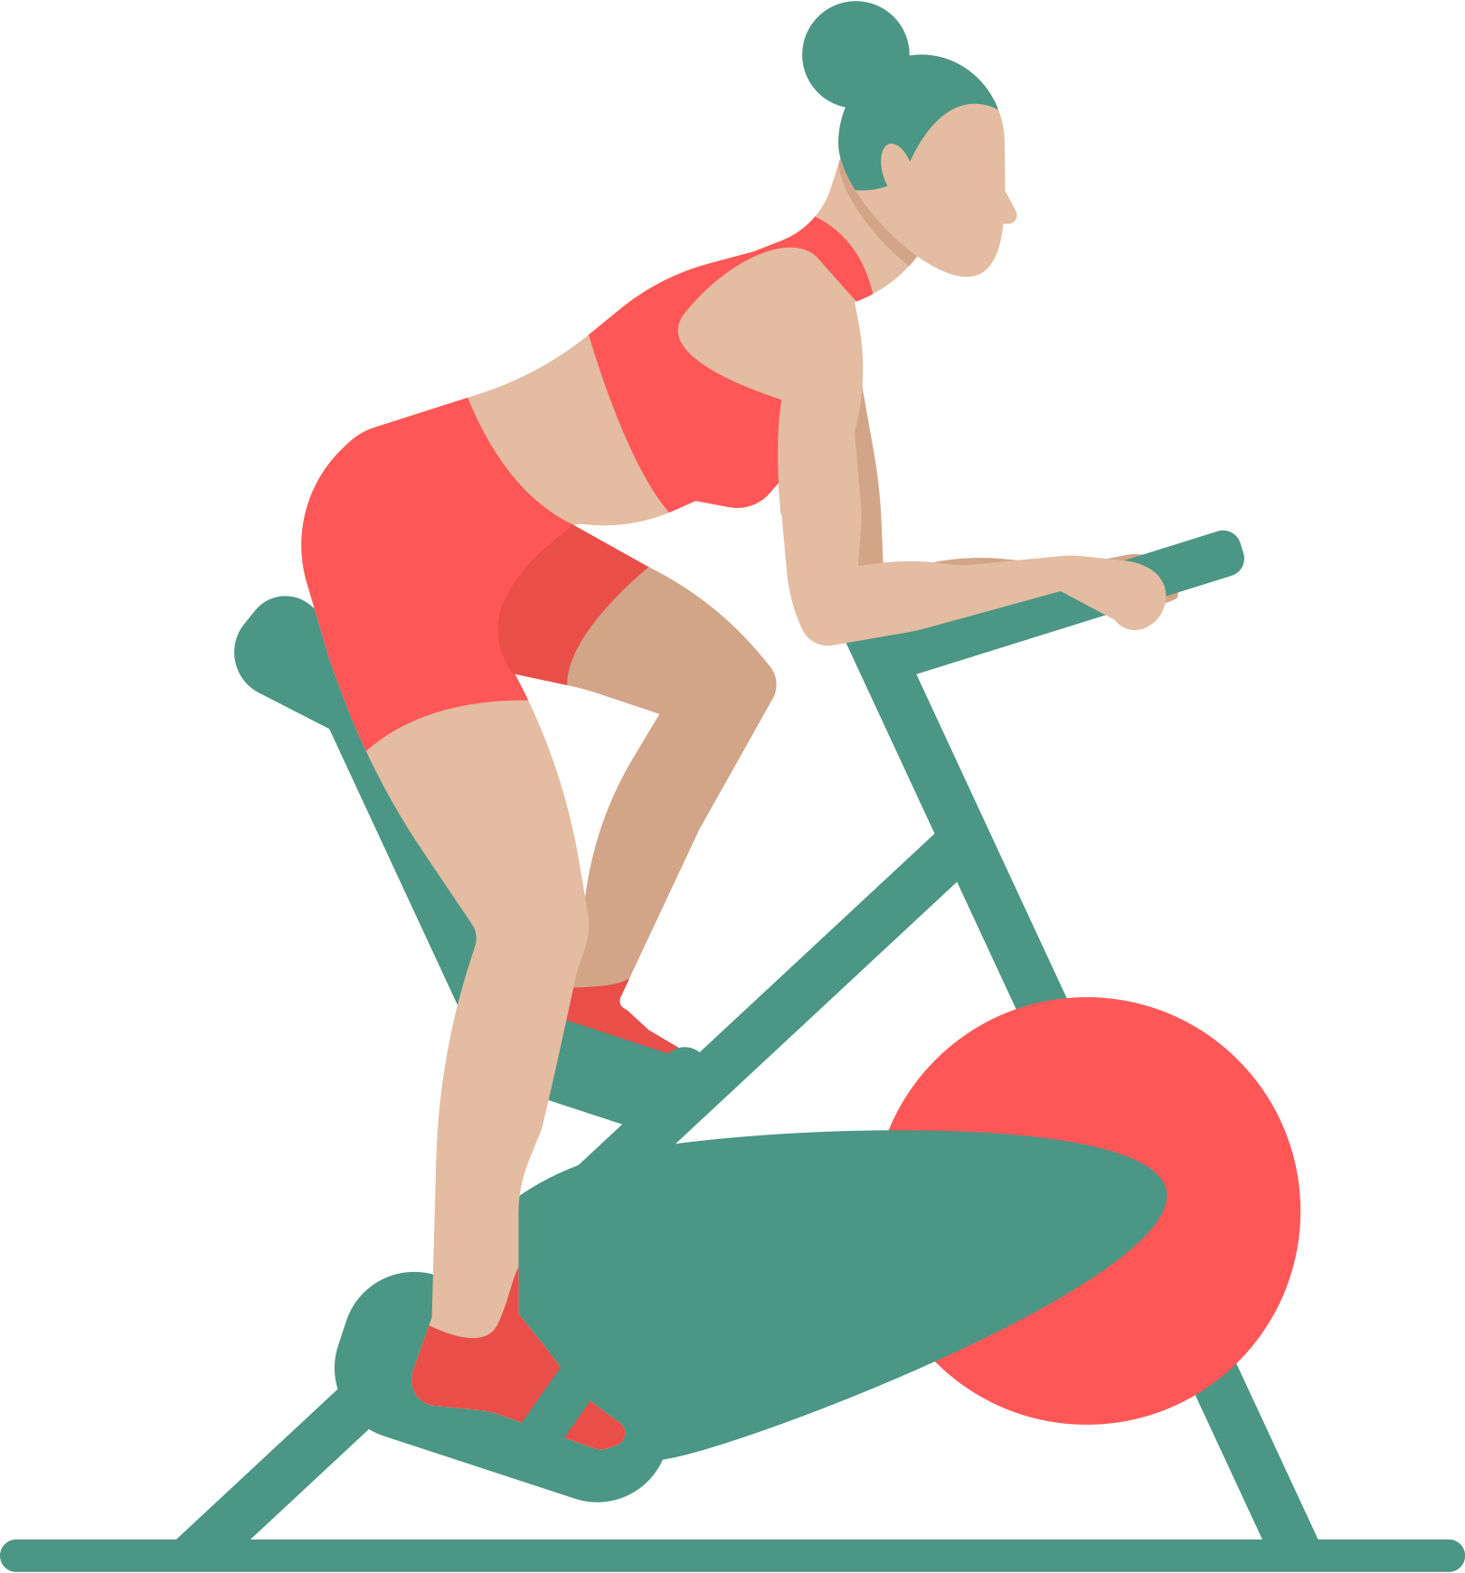
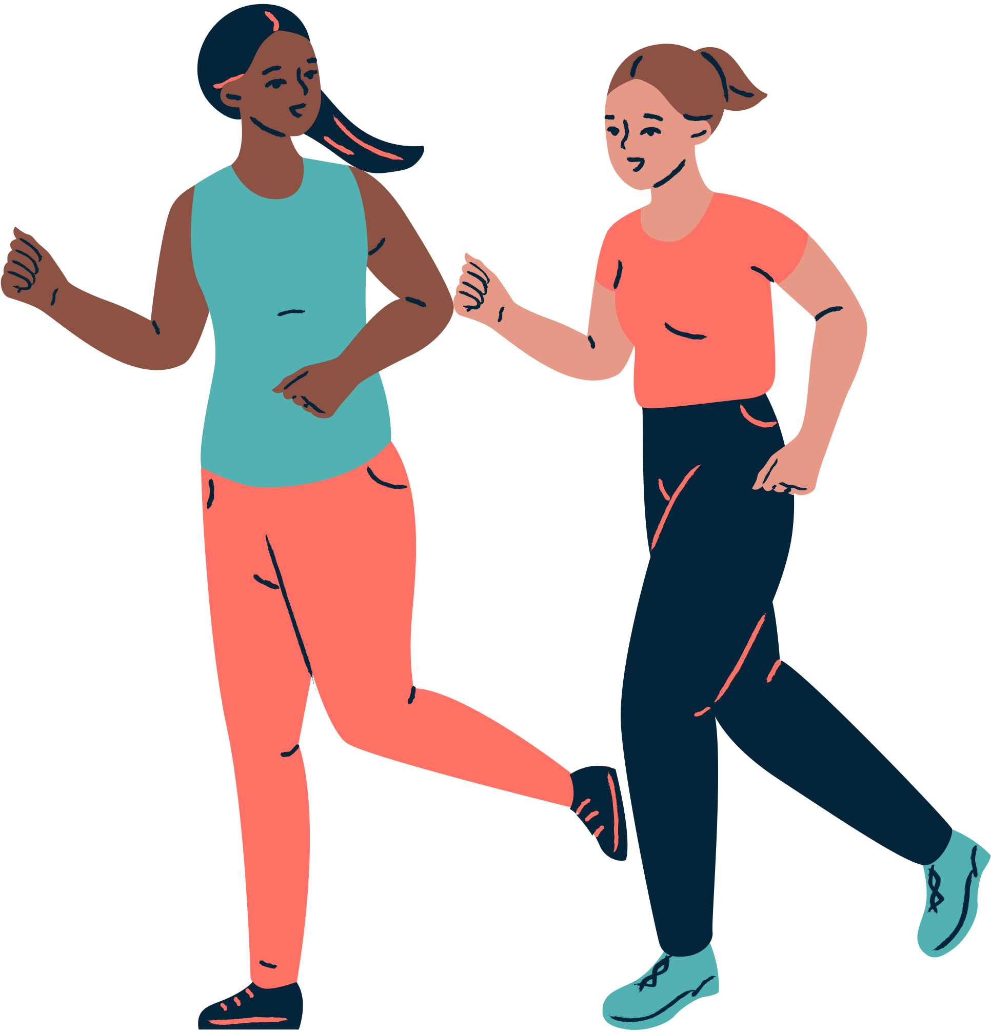
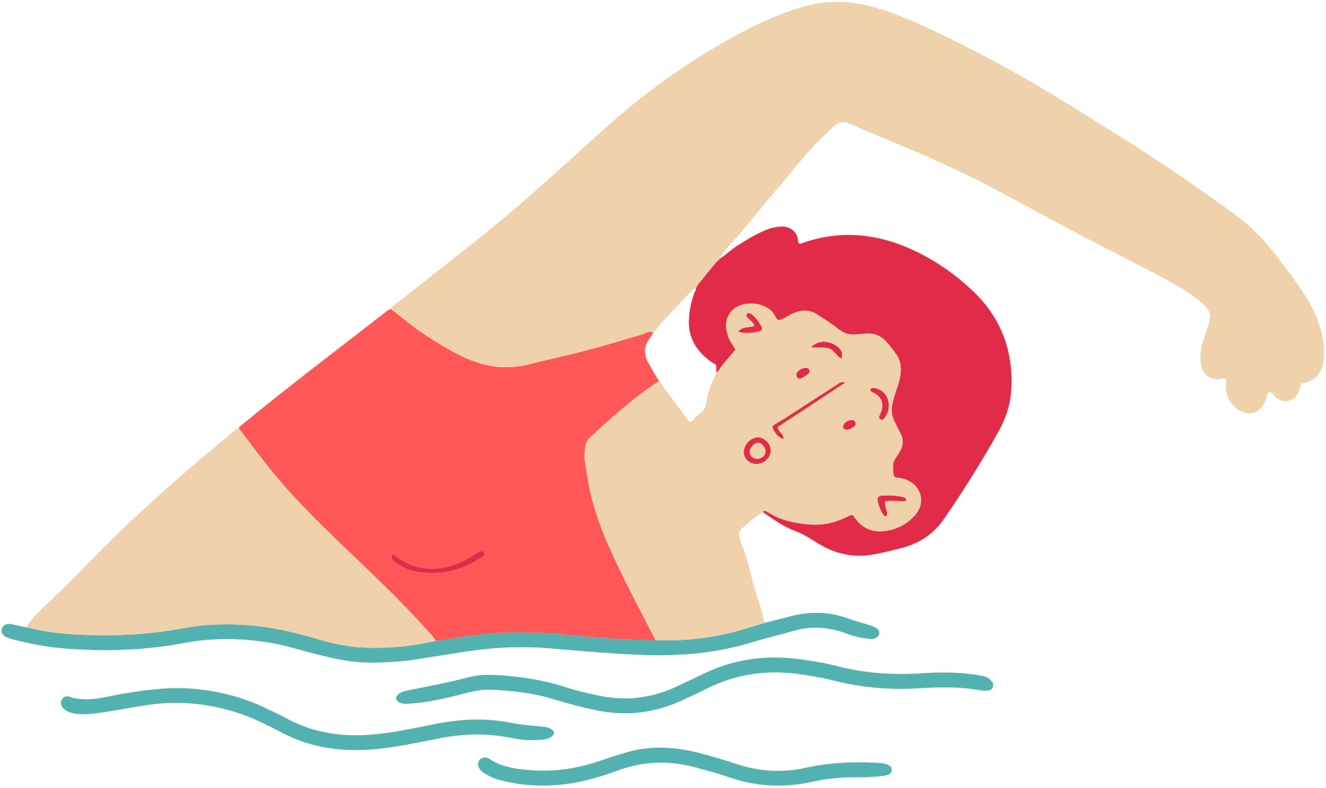
Period Education
UK
Taking part in PE during periods
Some activities can be especially beneficial for improving symptoms.
Gentle exercise and movement such as yoga, pilates, stretching, walking
Moderate intensity (aerobic/cardio) exercise such as jogging, dancing, swimming, cycling

Slide 19
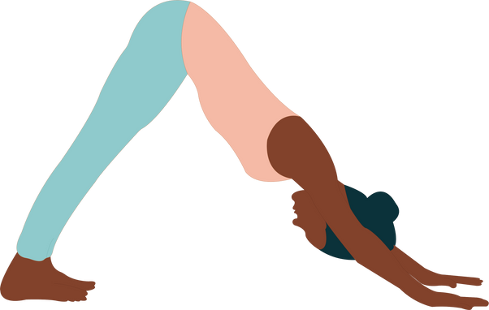
Period Education
UK
Taking part in PE during periods:
YOGA, PILATES, STRETCHING
Is thought to improve symptoms through increasing blood flow, improving muscle tension and how we react to stress and pain.
It also works on relaxation and mindfulness which are great ways to de-stress which in turn often helps symptoms.
Remember you don’t need to avoid certain yoga poses such as downward dog! You can go upside down on your period!

Slide 20
Period Education
UK
Taking part in PE during periods:
WALKING, JOGGING DANCING …
...Are thought to improve symptoms through increasing blood flow, increasing anti-inflammatory chemicals, releasing “feel-good hormones” called endorphins.
Even better if you can get outside to do some of this exercise.
It may be that you start off slower or at a lower intensity than you normally would. That’s absolutely fine!

Slide 21
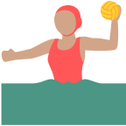
Period Education
UK
Taking part in PE during periods:
SWIMMING AND OTHER WATER SPORTS
Remember menstruators can swim (and do other water sports) during your period.
A period doesn't stop when in the water, but being in the water does reduce the flow of blood due to the pressure of the water.
Wearing a tampon, menstrual cup or period swimwear while swimming or doing water sports are all good options.
Period swimwear works in exactly the same way as period underwear with an absorbent lining to absorb blood.

Slide 22
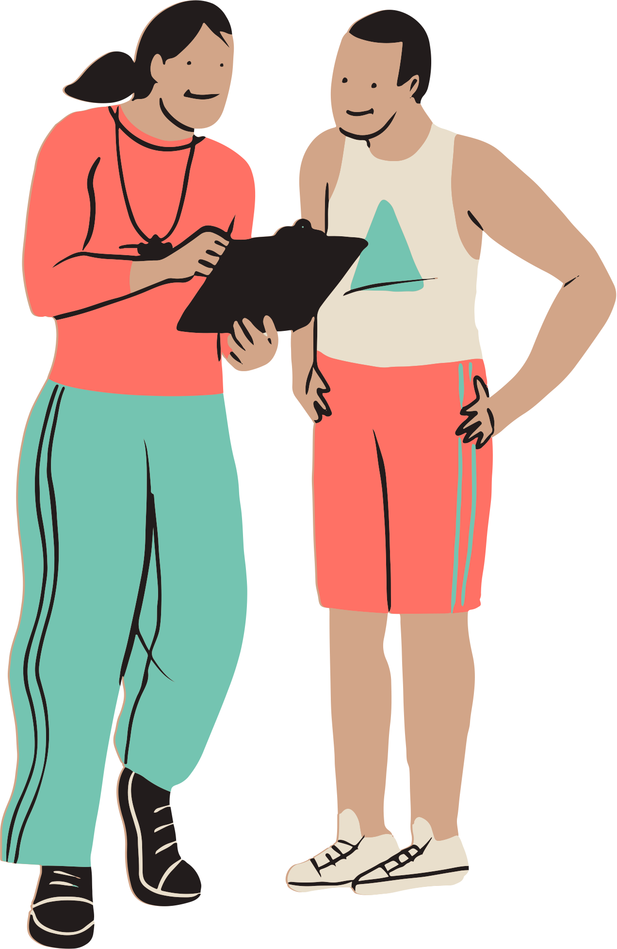
Period Education
“My period sometimes make me feel tired before a session, but [I] generally don’t have any noticeable effects during or after the session”
UK
Taking part in PE during periods
Try it, you might not feel like it but will probably feel better after it.
Don't be hard on yourself if you aren't able to perform to your usual ability, you may need to work at a lower intensity.
Try a ‘buddy system’ – tell a friend you’re on your period and they can reassure you that you’re not leaking or provide some gentle encouragement during exercise.
There may be other roles you can take if struggling e.g. umpiring and coaching

Slide 23
Period Education
INSTRUCTIONS
UK
Plan and Execute a Symptom Reliever Exercise Activity
Choose a menstrual related-symptom (e.g. cramps, backache, low mood, tiredness).
Plan a physical activity or exercise routine (think about the time and equipment needed) that would help improve symptoms
Do the physical activity or exercise routine aimed at helping relieve the symptoms.

Slide 24
Period Education
UK
SUMMARY
Physical activity is good for the menstrual cycle and periods and can help reduce menstrual cycle related symptoms (as well as being good for your physical and mental health!)
Scientific studies have shown that there are lots of different types of exercise and physical activities that can help with menstrual cycle symptoms. These include:
Gentle exercise and movement such as yoga, pilates, stretching, walking
Moderate intensity (aerobic/cardio) exercise such as jogging, dancing, swimming, cycling
Therefore, there are lots of ways menstruators can take part in PE even when on their period.

Slide 25
Authors ​and contributions:
Content developed by Dr Laura Forrest*, Dr Natalie Brown and Beky Williams.
Associated activities co-designed by Dr Laura Forrest, Dr Natalie Brown, Beky Williams, Dr Shirley Gray, Elaine Wotherspoon, Julie Isdale, Tilly O'Donnell.
Valuable feedback received from Megan Padden, Tracy Johnston, Dr Jessica Piasecki and Dr Georgie Bruinvels.
*Dr Laura Forrest was supported by the Royal Society of Edinburgh Research Fellowship during the development of these resources
​
Period Education ©2023 (www.periodeducation.org)​
All rights reserved. These resources may be reproduced by anyone working to promote the menstrual health of women and girls as long as it is clearly referenced. It may not be used for commercial purposes unless written permission has been obtained from Period Education. ​

